Slide 1
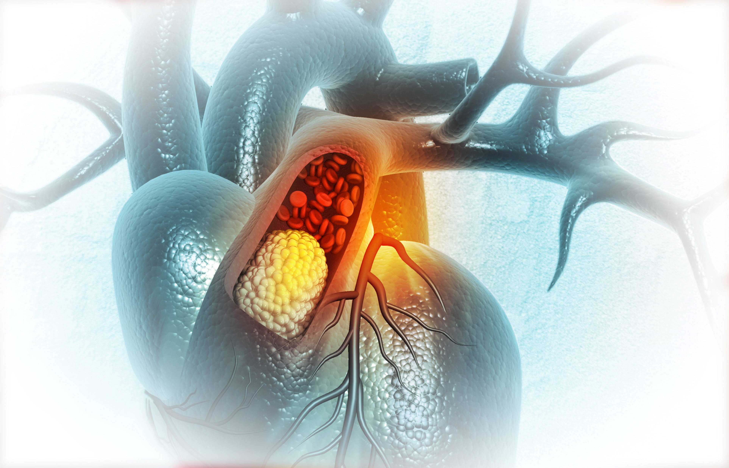

Dyslipidemia in Primary Care:
Implications of the 2021 CCS Dyslipidemia Guidelines

Slide 2

Presenter Disclosure
Presenter - [presenter name]
Relationships with financial sponsors:
Grants/Research Support:
Speakers Bureau/Honoraria:
Consulting Fees:
Patents:
Other:

Slide 3
Disclosure of Financial Support
This program has received financial support from Amgen Canada in the form of an educational grant.
This program has received in-kind support from Amgen Canada in the form of logistical support.
Potential for conflict(s) of interest:
[Presenter] has received [payment/funding, etc.] from [organization supporting this program AND/OR organization whose product(s) are being discussed in this program].
Amgen Canada developed, licenses, distributes and benefits from the sale of a product that will be discussed in this program

Slide 4
Mitigating Potential Bias
The Canadian Heart Research Centre (CHRC) assesses conflict of interest with its instructors, planners, managers and other individuals who are in a position to control the content of CME activities. All relevant conflicts of interest that are identified are thoroughly vetted by the CHRC for fair balance, scientific objectivity of studies utilized in this program, and patient care recommendations. The CHRC is committed to providing its learners with high quality CME activities and related materials that promote improvements or quality in healthcare and not a specific proprietary business interest of a commercial interest.
The speaker had provided a full disclosure in advance of the program. The scientific content of the program is evidence based and all content related to pharmacotherapy is within product label. The program has been peer reviewed.
[Presenter] has provided his disclosure information at the start of this presentation.

Slide 5

Program Development
This program was planned by the Canadian Heart Research Centre, a not-for-profit academic organization to achieve scientific integrity, objectivity, and balance.
This program has received an educational grant and in-kind support from Amgen Canada

Slide 6
Learning Objectives
Upon completion of this activity, participants will be able to:
01
Explain the key updates to the 2021 CCS Dyslipidemia Guidelines for primary and secondary prevention
02
Identify those patients who would benefit from additional therapy beyond statins to reduce CV risk
03
Appropriately apply the new 2021 CCS Dyslipidemia Guideline recommendations into routine clinical practice

Slide 7
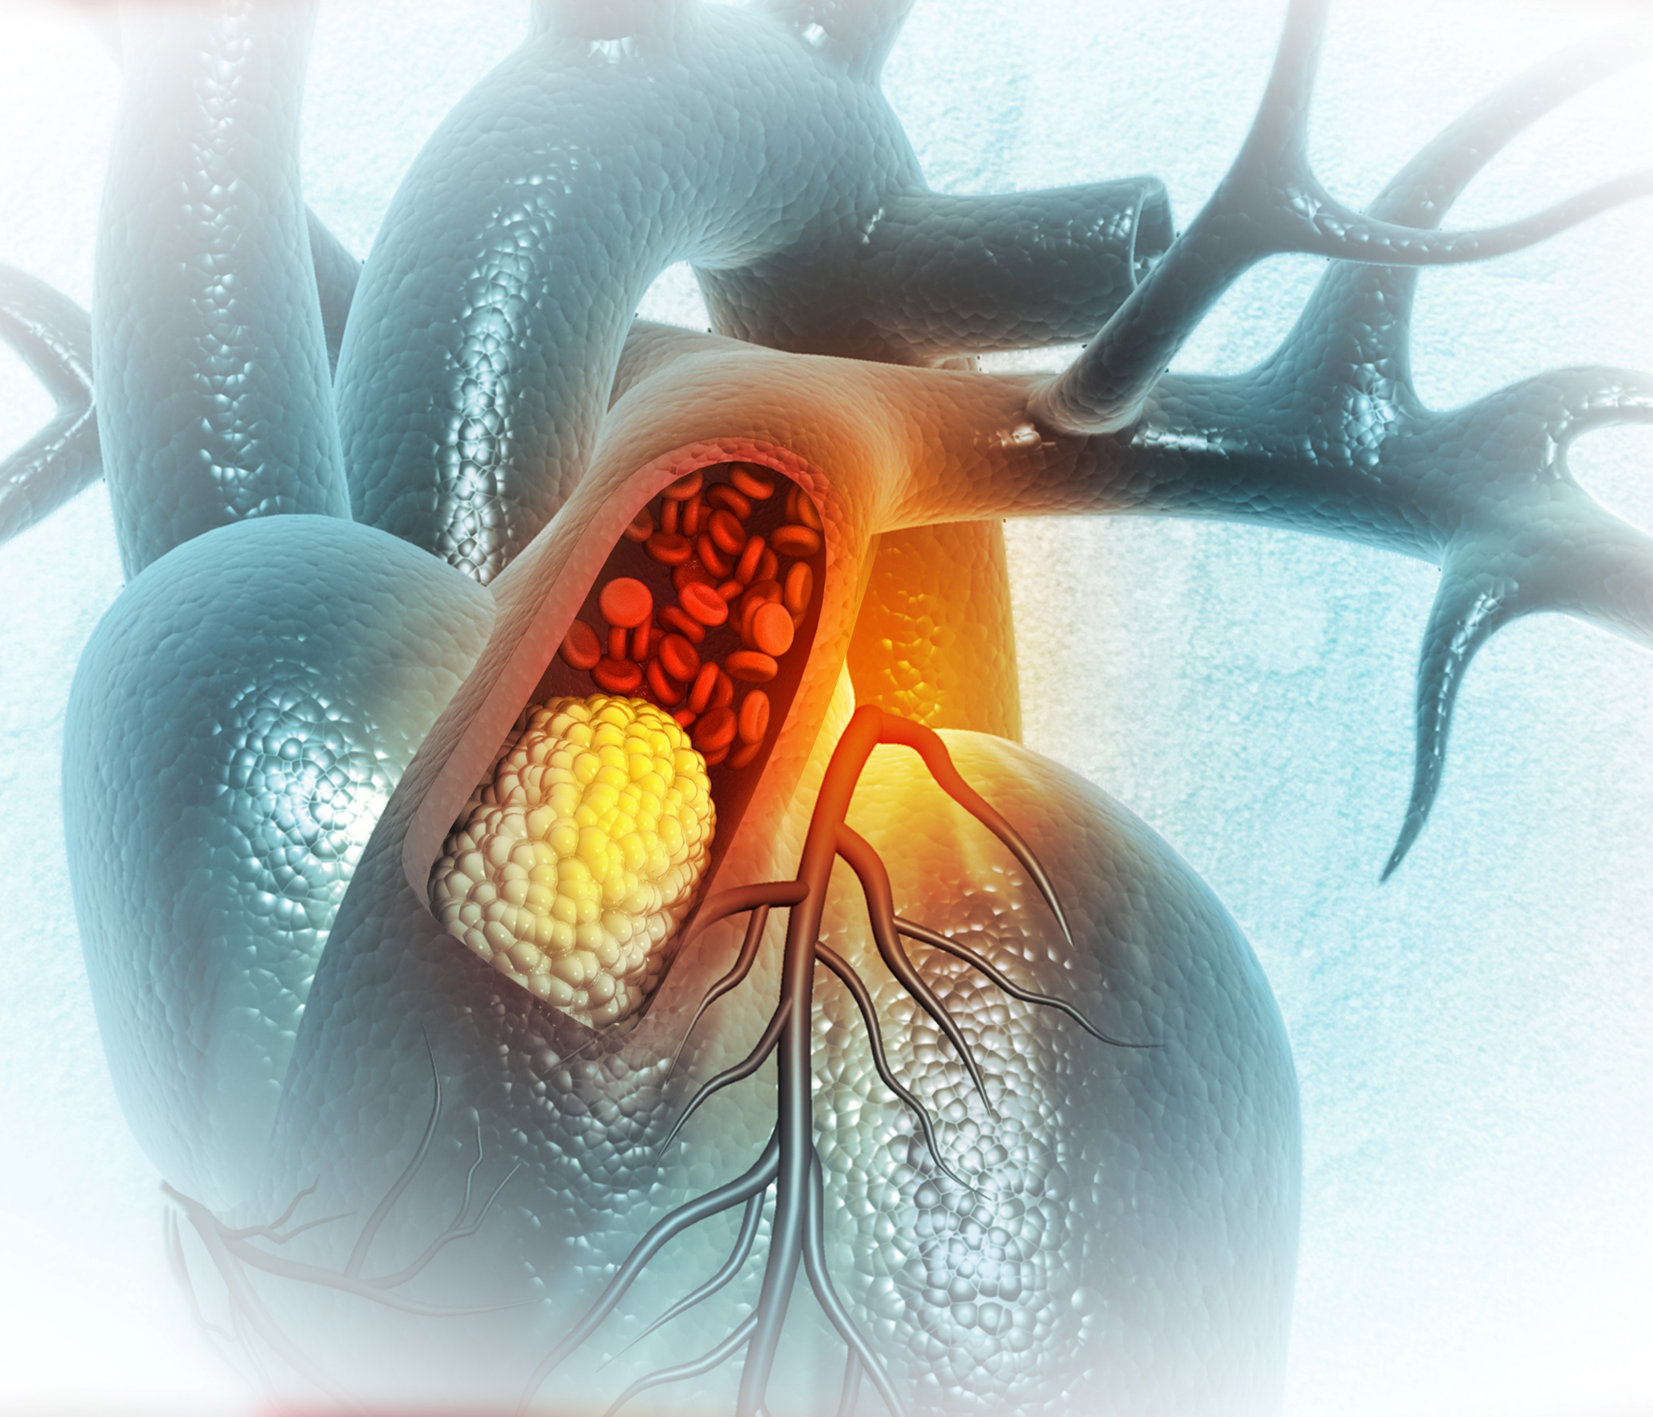
What We Already Know
Centrality of LDL-C Cholesterol

Slide 8
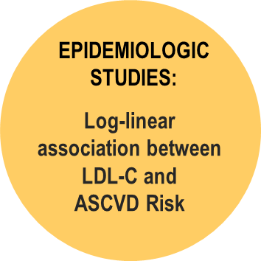
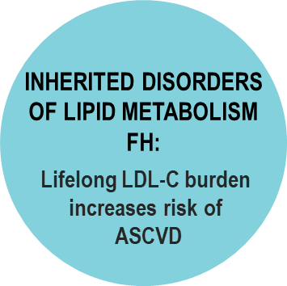
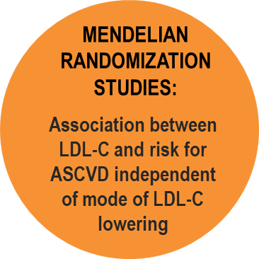
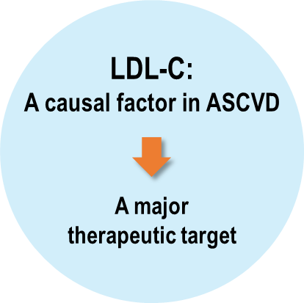
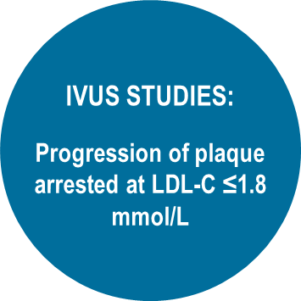
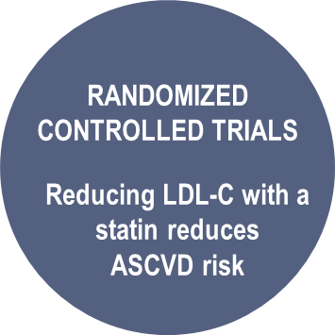
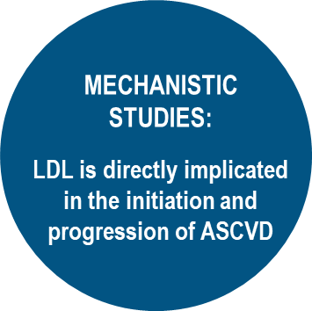
LDL-C is Strongly Associated with ASCVD*
*ASCVD: Atherosclerotic cardiovascular disease
FH: Familial Hypercholesterolemia
Ference BA, et al. Eur Heart J. 2017;38:2459-2472
Notes:
We assessed whether the association between LDL and ASCVD fulfils the criteria for causality by evaluating the totality of evidence from genetic studies, prospective epidemiologic cohort studies, Mendelian randomization studies, and randomized trials of LDL-lowering therapies. In clinical studies, plasma LDL burden is usually estimated by determination of plasma LDL cholesterol level (LDL-C). Rare genetic mutations that cause reduced LDL receptor function lead to markedly higher LDL-C and a dose-dependent increase in the risk of ASCVD, whereas rare variants leading to lower LDL-C are associated with a correspondingly lower risk of ASCVD. Separate meta-analyses of over 200 prospective cohort studies, Mendelian randomization studies, and randomized trials including more than 2 million participants with over 20 million person-years of follow-up and over 150 000 cardiovascular events demonstrate a remarkably consistent dose-dependent log-linear association between the absolute magnitude of exposure of the vasculature to LDL-C and the risk of ASCVD; and this effect appears to increase with increasing duration of exposure to LDL-C. Both the naturally randomized genetic studies and the randomized intervention trials consistently demonstrate that any mechanism of lowering plasma LDL particle concentration should reduce the risk of ASCVD events proportional to the absolute reduction in LDL-C and the cumulative duration of exposure to lower LDL-C, provided that the achieved reduction in LDL-C is concordant with the reduction in LDL particle number and that there are no competing deleterious off-target effects.
Conclusion
Consistent evidence from numerous and multiple different types of clinical and genetic studies unequivocally establishes that LDL causes ASCVD.

Slide 9

Evidence for LDL-C as a Main Priority for Risk Reduction
LDL-C compromises 75% of the cholesterol carried by circulating apo-B containing lipoproteins
LDL-C meets multiple criteria for causality related to ASCVD
LDL-C is the most studied lipid parameter in RCTs and the primary priority for lipid-lowering therapy
LDL-C reduction remains the main focus in guidelines
RCTs: Randomized Clinical Trials
Stone NJ, et al. The 2018 AHA/ACC/Multi-Society Cholesterol guidelines: Looking at past, present and future, Progress in Cardiovascular Diseases, Volume 62, Issue 5, 2019, 375-383,

Slide 10
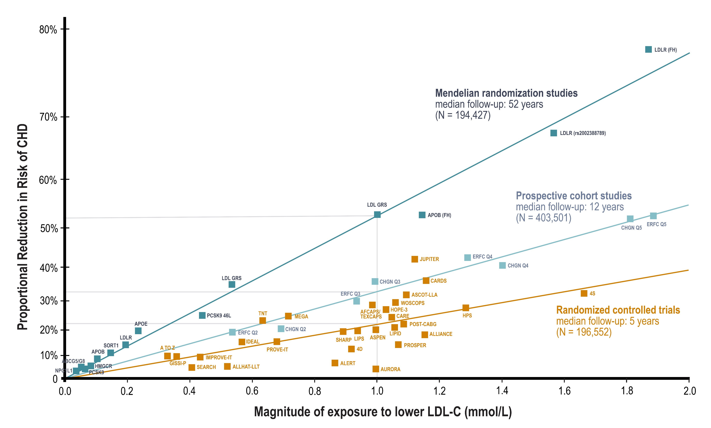
LDL-C is Strongly and Directly Associated with the Risk
of ASCVD Events
Continuous, dose-dependent and log-linear causal association between the magnitude of the absolute change in LDL-C level and the lifetime risk of CHD
Adapted from Ference BA et al. Eur Heart J. 2017 Apr 24. doi: 10.1093/eurheartj/ehx144.
Notes:
Log-linear association per unit change in low-density lipoprotein cholesterol (LDL-C) and the risk of cardiovascular disease as reported in meta-analyses of Mendelian randomization studies, prospective epidemiologic cohort studies, and randomized trials. The increasingly steeper slope of the log-linear association with increasing length of follow-up time implies that LDL-C has both a causal and a cumulative effect on the risk of cardiovascular disease. The proportional risk reduction (y axis) is calculated as 1−relative risk (as estimated by the odds ratio in Mendelian randomization studies, or the hazard ration in the prospective epidemiologic studies and randomized trials) on the log scale, then exponentiated and converted to a percentage. The included meta-analyses were identified from (i) MEDLINE and EMBASE using the search terms meta-analysis, LDL, and ‘cardiovascular or coronary’; (ii) the reference lists of the identified meta-analyses; (iii) public data from GWAS consortia; and (iv) by discussion with members of the EAS Consensus Panel. We included the most updated meta-analyses available, giving preference to meta-analyses that used individual participant data. Trial acronyms: AF/TexCAPS, Air Force/Texas Coronary Atherosclerosis Prevention Study; ALERT, Assessment of LEscol in Renal Transplantation; ALLHAT-LLT, Antihypertensive and Lipid-Lowering Treatment to Prevent Heart Attack Trial Lipid Lowering Trial; ALLIANCE, Aggressive Lipid-Lowering Initiation Abates New Cardiac Events; ASPEN, Atorvastatin Study for Prevention of Coronary Heart Disease Endpoints in non-insulin-dependent diabetes mellitus; ASCOT LLA, Anglo Scandinavian Cardiac Outcomes Trial Lipid Lowering Arm; AURORA, A Study to Evaluate the Use of Rosuvastatin in Subjects on Regular Hemodialysis: An Assessment of Survival and Cardiovascular Events; CARE, Cholesterol and Recurrent Events; CARDS, Collaborative Atorvastatin Diabetes Study; CHGN, Community Health Global Network; 4D Deutsche Diabetes Dialyse Studies; ERFC, Emerging Risk Factors Collaboration; GISSI, Gruppo Italiano per lo Studio della Sopravvivenza nell'Infarto Miocardico; HOPE, Heart Outcomes Prevention Evaluation Study; HPS, Heart Protection Study; IDEAL, Incremental Decrease in End Points Through Aggressive Lipid Lowering; IMPROVE-IT, Examining Outcomes in Subjects With Acute Coronary Syndrome: Vytorin (Ezetimibe/Simvastatin) vs Simvastatin; JUPITER, Justification for the Use of Statins in Primary Prevention: An Intervention Trial Evaluating Rosuvastatin trial; LIPID,, Long-Term Intervention with Pravastatin in Ischemic Disease; LIPS, Lescol Intervention Prevention Study; MEGA, Management of Elevated Cholesterol in the Primary Prevention Group of Adult Japanese; POST-CABG, Post Coronary Artery Bypass Graft; PROSPER, Pravastatin in elderly individuals at risk of vascular disease; PROVE-IT, Pravastatin or Atorvastatin Evaluation and Infection Therapy; SHARP, Study of Heart and Renal Protection; TNT, Treating to New Targets; WOSCOPS, West of Scotland Coronary Prevention Study.

Slide 11
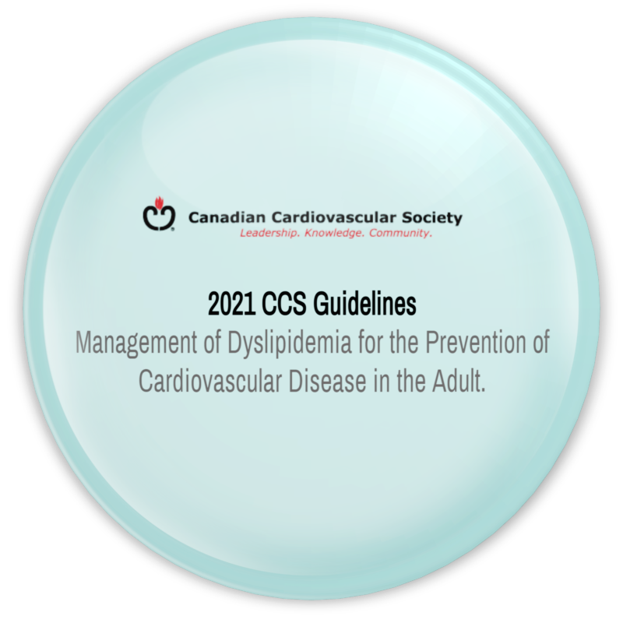
2021 CCS Guidelines Update:
What is New and Relevant in Primary Prevention

Slide 12
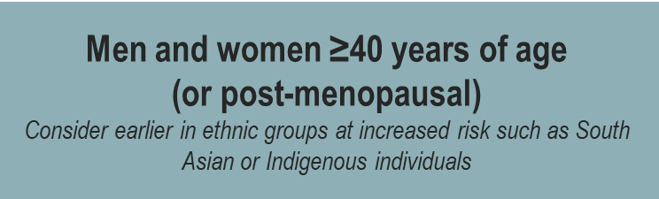
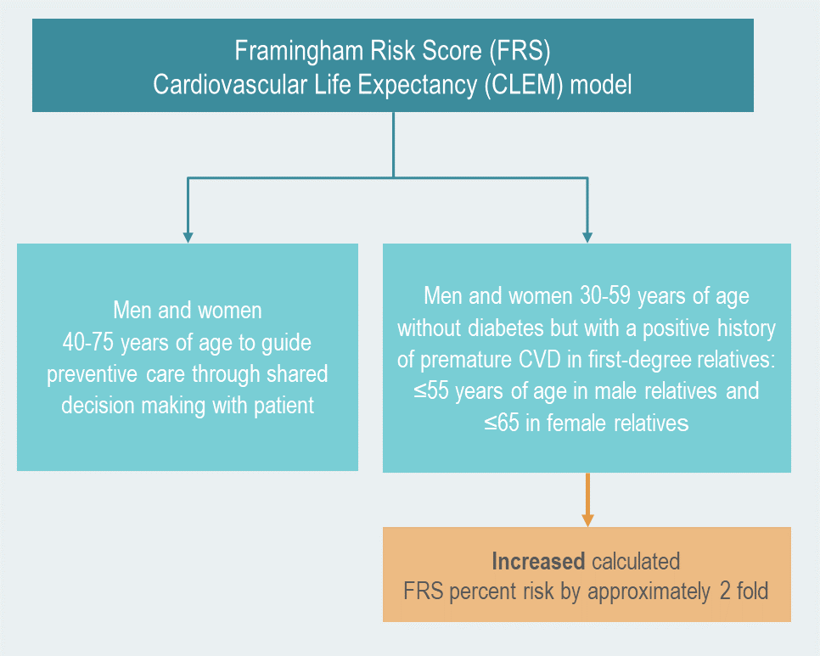

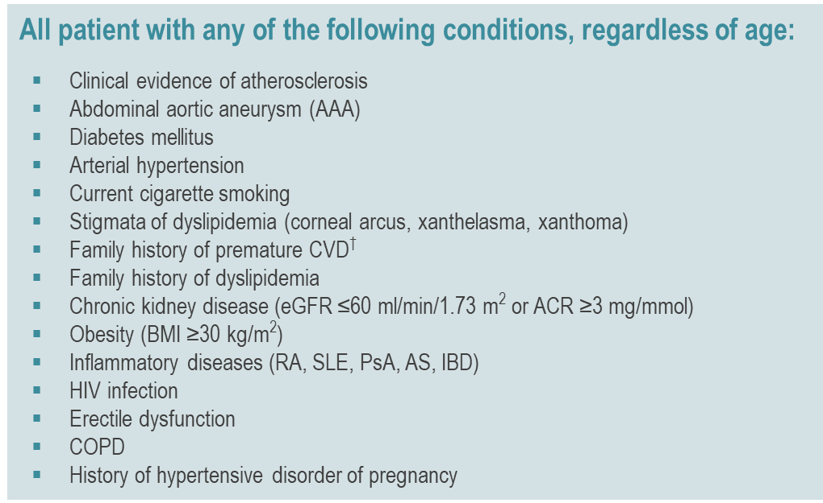
Screening Recommendations for Primary Prevention Patients
Who to Screen for Dyslipidemia in Adults at Risk
Assess every 5 years
*Adapted from the 2021 Canadian Cardiovascular Society Guidelines for the Management of Dyslipidemia for the Prevention of Cardiovascular Disease in the Adult. †Men younger than 55 years of age and women younger than 65 years of age in first degree relatives. ACR, albumin-to-creatinine ratio; AS, ankylosing spondylitis; BMI, body mass index; COPD, chronic obstructive pulmonary disease; CVD, cardiovascular disease; eGFR, estimated glomerular filtration rate; HIV, human immunodeficiency virus; IBD, inflammatory bowel disease; PsA, psoriatic arthritis; RA, rheumatoid arthritis; SLE, systemic lupus erythematous; TG, triglycerides. Pearson et al. 2021 Canadian Cardiovascular Society Guidelines for the Management of Dyslipidemia for the Prevention of Cardiovascular Disease in the Adult. From: https://doi.org/10.1016/j.cjca.2021.03.016

Slide 13
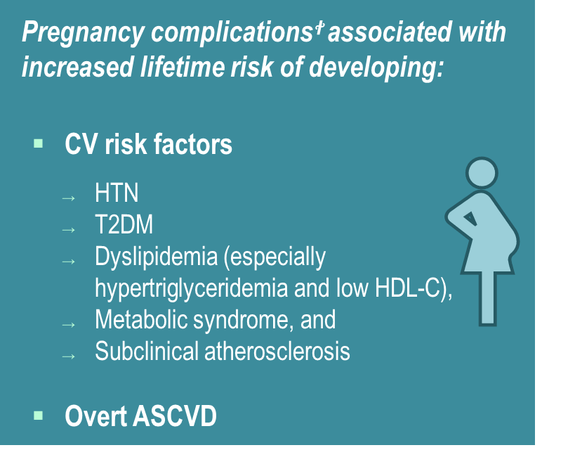
NEW
Pregnancy Related Disorders - Recommendation
Among women who have had a pregnancy complication such as hypertensive diseases of pregnancy, gestational diabetes, pre-term birth, stillbirth, low birthweight infant, or placental abruption, screening with a lipid panel in the late postpartum period is recommended, since these women have a higher risk of premature CVD and stroke with onset 10 - 15 years after index delivery. (Strong Recommendation; Moderate-Quality Evidence)
Counselling women who have any of these pregnancy-related complications of the increased lifetime risk of ASCVD and reinforcing the importance of healthy behaviours is recommended. (Strong Recommendation; Low Quality Evidence.)
To assist with decisions about lipid-lowering pharmacotherapy in this patient population, favouring CV age, over 10-year risk calculators is recommended. (Strong Recommendation; Low Quality Evidence)
Preeclampsia increases RR of developing pre-menopausal ASCVD by 2-fold
ꭝPregnancy complications include: preeclampsia and related hypertensive disorders of pregnancy, gestational diabetes, placental abruption, preterm delivery, stillbirth, and delivery of a lowbirth weight infant. ASCVD, atherosclerotic cardiovascular disease; CV, cardiovascular; HDL-C, high-density lipoprotein cholesterol; HTN, hypertension; RR, relative risk; T2DM, type 2 diabetes mellitus. Pearson et al. 2021 Canadian Cardiovascular Society Guidelines for the Management of Dyslipidemia for the Prevention of Cardiovascular Disease in the Adult. From: https://doi.org/10.1016/j.cjca.2021.03.016
Notes:
Values and preferences. Although much of this observed risk among women who have had a pregnancyrelated complication might be due to conventional ASCVD risk factors, complications such as preeclampsia might lead to ASCVD through accelerated vascular aging or other pathways warranting additional future research. Q7 There is insufficient evidence to guide decisions about use of lipid-lowering therapy in women on the basis of pregnancy factors alone. The American Heart Association 2019 CV prevention guidelines27 consider preeclampsia a risk enhancer warranting early screening, healthy behaviour interventions, and possibly shifting of risk category from borderline to intermediate risk (ie, eligible for statin or other lipid-lowering therapy)

Slide 14

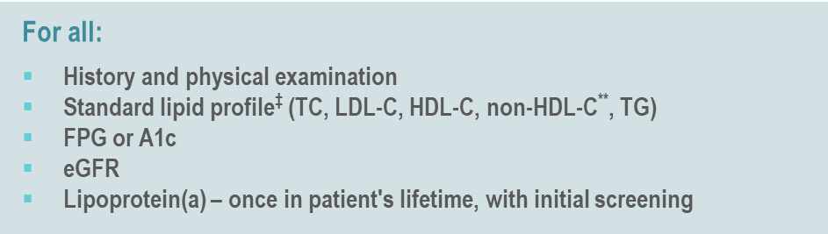

Screening Recommendations for Primary Prevention Patients
How to Screen for Dyslipidemia in Adults at Risk
Lipids can be measured non-fasting
(except if TGs >4.5 mmol/L)
Practical Tip:
Compared to fasting lipid values there will be minimal change with non-HDL-C, a slight decrease in LDL-C and small increase in triglyceride concentrations in individuals who did not fast
*Adapted from the 2021 Canadian Cardiovascular Society Guidelines for the Management of Dyslipidemia for the Prevention of Cardiovascular Disease in the Adult.
Notes:
‡Non-fasting lipid testing is recommended in most adults for screening; however, for individuals with a history of triglyceride levels >4.5 mmol/L, measurement of fasting lipid levels are recommended. **It is now generally preferable to follow non-HDL-C or ApoB levels over LDL-C when interpreting lipid results, particularly when TG is ≥1.5 mmol/L. A1c, glycated hemoglobin; ACR, albumin-to-creatinine ratio; eGFR, estimated glomerular filtration rate; FPG, fasting plasma glucose; HDL-C, high-density lipoprotein cholesterol; LDL-C, low-density lipoprotein cholesterol; TC, total cholesterol; TG, triglycerides. Pearson et al. 2021 Canadian Cardiovascular Society Guidelines for the Management of Dyslipidemia for the Prevention of Cardiovascular Disease in the Adult. From: https://doi.org/10.1016/j.cjca.2021.03.016

Slide 15
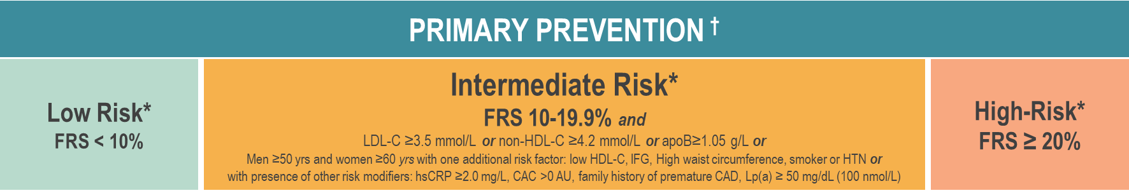
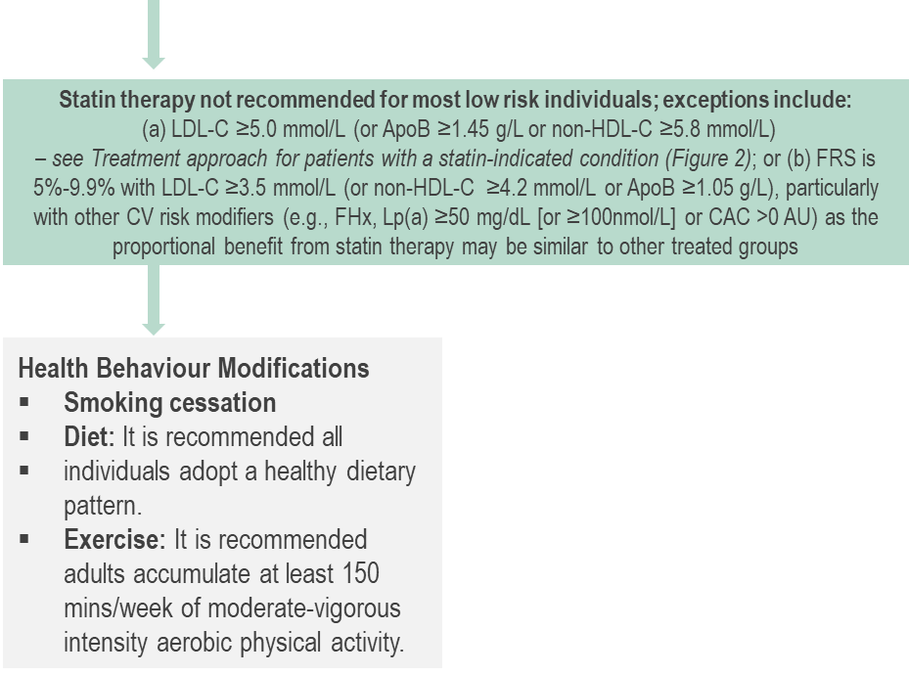
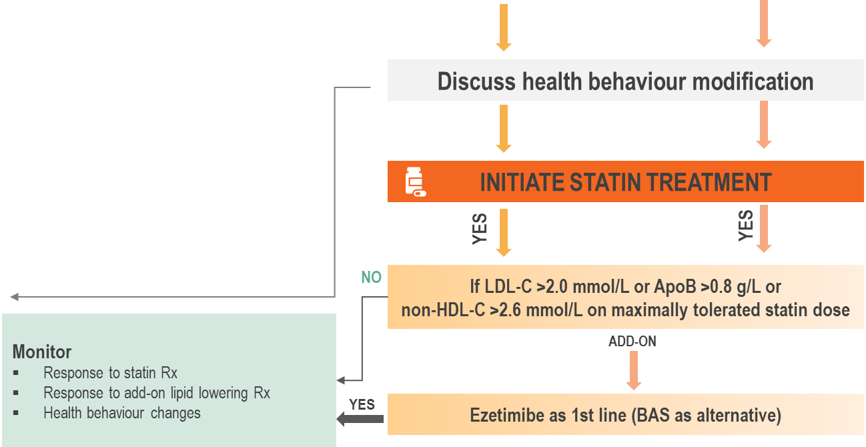
Treatment Approach for Primary Prevention Patients
(Without a Statin Indicated Condition)
Calculate Framingham risk score to guide whether statin therapy is recommended.
Health behaviour changes remain the cornerstone of disease prevention.
Pearson GJ, et al. 2021 CCS Guidelines for the Management of Dyslipidemia for the Prevention of Cardiovascular Disease in the Adult. CJC. 2021;0(0). doi:10.1016/j.cjca.2021.03.016
Notes:
‡ Statin indicated conditions consists of all documented ASCVD conditions, as well other high-risk primary prevention conditions in the absence of ACSVD, such as most patients with diabetes, those with chronic kidney disease and those with a LDL-C ≥5.0 mmol/L
† Calculate risk using the Framingham Risk Score (FRS)
* Screening should be repeated every 5 years for men and women aged 40-75 years using the modified FRS or CLEM to guide therapy to reduce major CV events. A risk assessment might also be completed whenever a patient’s expected risk status changes.
¶ studies have evaluated the efficacy of BAS for the prevention of ASCVD, but results have been inconclusive
FRS = Framingham risk score; LDL-C = low-density lipoprotein cholesterol; HDL-C = high-density lipoprotein cholesterol; ApoB = apolipoprotein B; IFG = impaired fasting glucose; HTN = hypertension; hsCRP = hig-sensitivity C-reactive protein; CAC = coronary artery calcium; AU – Agatston unit; Rx = prescription; BAS = bile acid sequestrant
Figure 1.
Treatment approach for primary prevention patients (without a statin-indicated condition*). Statin-indicated conditions consist of all documented ASCVD conditions, as well as other high-risk primary prevention conditions in the absence of ASCVD, such as most patients with diabetes, those with chronic kidney disease, and those with an LDL-C ≥ 5.0 mmol/L. Screening should be repeated every 5 years for men and women aged 40-75 years using the modified FRS or Cardiovascular Life Expectancy Model (CLEM) to guide therapy to reduce major CV events. A risk assessment might also be completed whenever a patient’s expected risk status changes. ApoB, apolipoprotein B; ASCVD, atherosclerotic cardiovascular Q6 disease; AU, Agatston units; BAS, bile acid sequestrant; CAC, coronary artery calcium; CAD, coronary artery disease; CV, cardiovascular; FHx, XXX; HDL-C, high-density lipoprotein cholesterol; hsCRP, high-sensitivity C-reactive protein; HTN, hypertension; FRS, Framingham Risk Score; IFG, impaired fasting glucose; LDL-C, low-density lipoprotein cholesterol; Lp(a), lipoprotein(a); mins, minutes; Rx, treatment; yrs, years. * Calculate risk using the FRS—refer to the iCCS available on the App Store or on Google Play.
Statin Indicated Conditions: Figure 2: - STATIN INDICATED CONDITIONS
LDL-C ≥5.0 mmol/L (or apoB≥1.45 g/L or non-HDL-C ≥5.8 mmol/L) (Familiar hypercholesterolemia or genetic dyslipidemia)
Most patients with diabetes:
Age ≥40y
Age ≥30y & DM x >15y duration
Microvascular disease
Chronic Kidney Disease
Age ≥50y and eGFR <60 mL/min/1.73 m² or ACR >3 mg/mmol
Atherosclerotic Cardiovascular Disease (ASCVD):
Myocardial infarction (MI), acute coronary syndromes (ACS)
Stable angina, documented coronary artery disease by angiography
Stroke, TIA, documented carotid disease
Peripheral arterial disease, claudication and/or ABI <0.9
Abdominal aortic aneurysm (AAA) - abdominal aorta >3.0 cm or previous aneurysm surgery

Slide 16
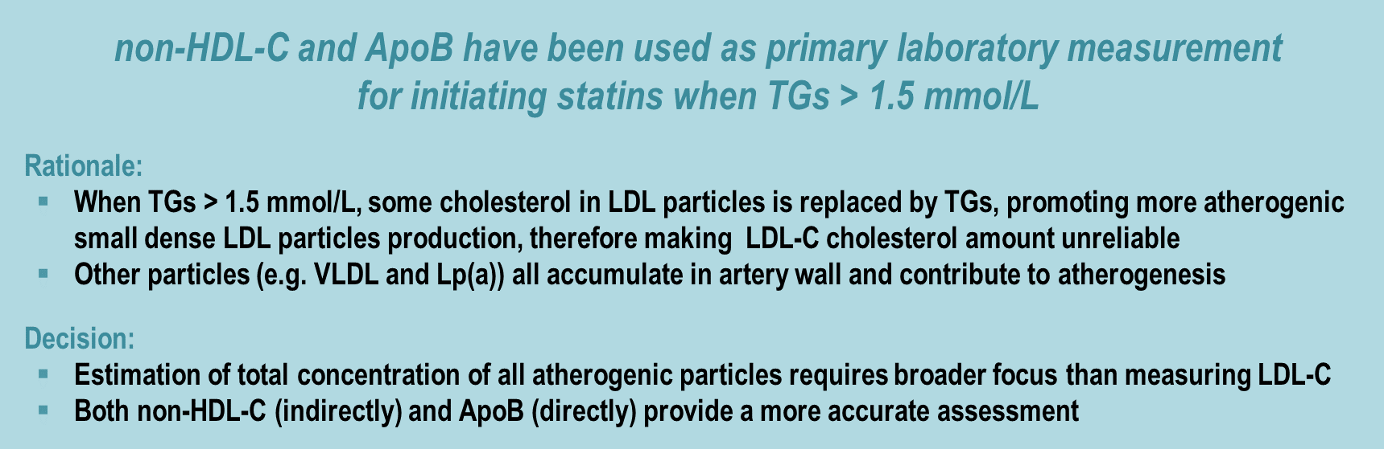


NEW
Non-HDL-C vs. ApoB: Which is Preferred for Screening and Treatment Purposes?
Non-HDL-C and ApoB appear to be superior to LDL-C in CV event risk prediction
Lab Testing in Canadaꭞ
non-HDL-C is now routinely reported across Canada at no added cost
ApoB is also available as an insured lab test in all provinces except Ontario
It is recommended that for any patient with triglycerides > 1.5 mmol/L, non-HDL-C or ApoB be used instead of LDL-C as the preferred lipid parameter for screening. (Strong Recommendation; High Quality Evidence)
ꭞIn Canada, the approach has been to allow clinicians to utilize either non-HDL-C or ApoB as their preferred parameter for assessment of risk and achievement of treatment targets, depending on their comfort level with the two measurements, availability of ApoB in their region and when there may be a concern about discordance between the two measurements. ApoB, apolipoprotein B; CV, cardiovascular; HDL-C, high-density lipoprotein cholesterol; LDL-C, low-density lipoprotein cholesterol; Lp(a), lipoprotein a; TGs, triglycerides; VLDL, very low density lipoprotein. Pearson et al. 2021 Canadian Cardiovascular Society Guidelines for the Management of Dyslipidemia for the Prevention of Cardiovascular Disease in the Adult. From: https://doi.org/10.1016/j.cjca.2021.03.016
Notes:
Non-HDL-C or ApoB for predicting CVD risk In population studies, non-HDL-C and ApoB can be considered as equivalent markers of total atherogenic lipoproteins and lipid-related CV risk and this applies to most individuals.41 Publications since the 2016 update of these guidelines indicate a subgroup of individuals, estimated at between 8% and 23%, have discordance between ApoB and non-HDL-C levels in whom ApoB might be the better predictor of risk for coronary calcification41 and ASCVD events.42 Analysis of CV events in the large United Kingdom Biobank,42 and metaanalysis of 110 prospective cohort registries of patients with or at risk for ASCVD,43 however, showed an overall similar ability of non-HDL-C and ApoB to predict risk, but confirmed both of these measures to be superior to LDL-C. Recent consensus statements have concluded that non-HDL-C is currently a more practical choice because it incurs no additional expense to the patient or health care system.44,45 In Canada, the approach has been to allow clinicians to use either nonHDL-C or ApoB as their preferred parameter for assessment of risk and achievement of treatment targets, depending on their comfort level with the two measurements, availability of ApoB testing in their region, and when there might be a concern about discordance between the two measurements, as indicated previously. In the current guidelines, we are continuing this recommendation, while strongly urging the routine use of either non-HDL-C or ApoB instead of LDL-C as the lipid level of interest in initial lipid screening and as a treatment target in all patients with triglyceride level > 1.5 mmol/L.

Slide 17

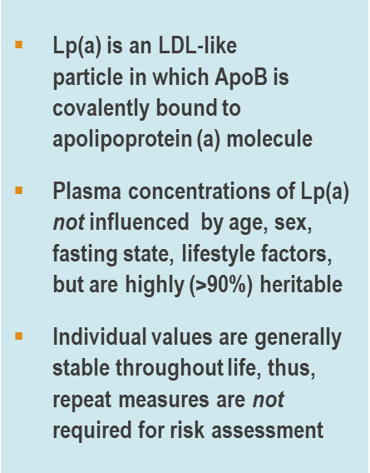
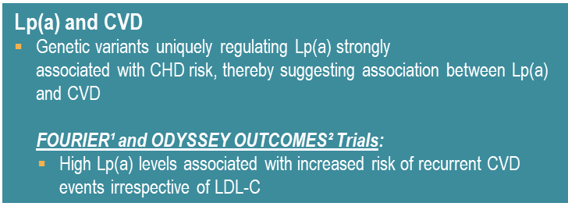
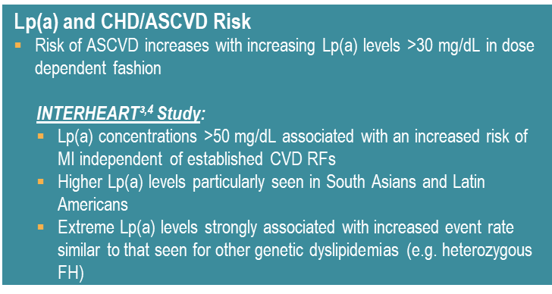
NEW
Can Lp(a) Improve Risk Stratification and Dyslipidemia Management?
6 million Canadians have high Lp(a) - most common genetic dyslipidemia
High concentrations of Lp(a) are associated with high risk of recurrent CVD in individuals from the general population
Commonly used agents such as statins and ezetimibe) do not adequately lower Lp(a)
PCSK9 inhibitors, niacin, and apheresis can lower Lp(a) levels, but relatively limited evidence currently exists for their use
Measuring Lp(a) level once in a person’s lifetime is recommended as a part of the initial lipid screening. (Strong Recommendation; High Quality Evidence)
For all patients in the setting of primary prevention with a Lp(a) ≥50 mg/dL (or ≥100 nmol/L), earlier and more intensive health behaviour modification counselling and management of other ASCVD risk factors is recommended. (Strong recommendation; Expert consensus)
Lab Testing in Canadaꭞ
Lp(a) is not currently considered a treatment target. However, Lp(a) testing is available across Canada, and is currently an insured laboratory test in most provinces, except in Ontario and Manitoba
1. O'Donoghue ML, Fazio S, Giugliano RP, et al. Lipoprotein(a), PCSK9 Inhibition, and Cardiovascular Risk. Circulation 2019;139(12):1483-92; 2. Bittner VA, Szarek M, Aylward PE, et al. Effect of Alirocumab on Lipoprotein(a) and Cardiovascular Risk After Acute Coronary Syndrome. JACC 2020;75(2):133-44; 3. Pare G, Caku A, McQueen M, Anand SS, Enas E, Clarke R, et al. Lipoprotein(a) Levels and the Risk of Myocardial Infarction Among 7 Ethnic Groups. Circulation. 2019;139(12):1472-82; 4. Enkhmaa B, Anuurad E, Berglund L. Lipoprotein (a): impact by ethnicity and environmental and medical conditions. J Lipid Res. 2016;57(7):1111-25. ASCVD, atherosclerotic cardiovascular disease; CHD, coronary heart disease; CVD, cardiovascular disease; FH, familial hypercholesterolemia; LDL-C, low density lipoprotein cholesterol; Lp(a), lipoprotein a; RCTs, randomized controlled trials; RFs, risk factors. Content adapted from: Pearson et al. 2021 Canadian Cardiovascular Society Guidelines for the Management of Dyslipidemia for the Prevention of Cardiovascular Disease in the Adult. From: https://doi.org/10.1016/j.cjca.2021.03.016
Notes:
Animated slide: content behind
Can be shown if speaker prefers - Although Lp(a) is not currently considered a treatment target, Lp(a) testing is available across Canada, and is currently an insured laboratory test in most provinces, except in Ontario and Manitoba.
Values and preferences. There is a large body of evidence supporting the potential causal association between Lp(a) and future ASCVD.51,52,57-60 The high prevalence of elevated Lp(a) level, the strength of association with incident and recurrent ASCVD events, and the potential to improve CV risk stratification, strongly justify universal screening to identify individuals with very high levels. Identification of high levels of Lp(a) is a useful consideration for shared decision-making in subjects across all ASCVD risk categories, but especially in younger patients, particularly those who have a very strong family history of premature ASCVD. Although further evidence that directly lowering Lp(a) level reduces ASCVD risk is pending, the finding of high Lp(a) should alert primary care practitioners to more actively pursue an overall ASCVD event risk assessment, including careful discussion of current health behaviours, consideration of age-appropriate vascular imaging studies for detecting early evidence of subclinical atherosclerosis in select individuals (eg, CAC score), and earlier introduction of statin or other lipid-lowering therapy, especially in intermediate-risk individuals and/or low-risk individuals with moderate elevations of LDL-C between 3.5 and 5 mmol/L. In the setting of secondary prevention, the presence of a high Lp(a) level is strongly predictive of recurrent events, and suggests the need for intensification of LDL-lowering therapy, including use of PCSK9 inhibitors. Furthermore, preliminary evidence suggests that treatment with PCSK9 inhibitors post ACS in patients with high Lp(a) reduces MACE independent of LDL-C lowering.56 When clinicians are uncertain of the implications of elevated Lp(a), consultation with a lipid specialist might be considered.

Slide 18
Coronary Artery Calcium Scoring (CAC):
CAC adds to risk prediction beyond FRS
Coronary artery calcium testing is useful in diagnosing subclinical coronary artery disease and in predicting the risk of future cardiovascular events and death.
Given the high negative predictive value of the test, it can also serve to reclassify risk in patients beyond traditional risk factors. CAC adds to risk prediction beyond FRS.
Along with shared decision-making, elevated calcium scores can guide the initiation of statin or aspirin therapy.
Repeat CAC testing is not recommended.
How to interpret CAC
CAC = 0 (true normal) has a negative predictive value in low -risk adults of 95-99% over 2-5 years, event rate of 1.5% over 10 years (not a zero rate of events).
CAC > 0 confirms presence of atherosclerotic plaque, and increasing scores are directly proportional to increased risk.
CAC > 100 is associated with high risk (>2% annual risk).
Even if CAC = 0, patients with strong family history, poorly controlled risk factors, Familial Hypercholesterolemia (FH) or elevated Lp(a) still warrant consideration of treatment.
Parth P. et al; Cleveland Clinic Journal of Medicine September 2018, 85 (9) 707-716; DOI: https://doi.org/10.3949/ccjm.85a.17097
Notes:
CAC screening using computed tomography imaging may be considered for asymptomatic adults ≥ 40 years and at intermediate risk (FRS 10%- 20%) for whom treatment decisions are uncertain is suggested. (Strong Recommendation, Moderate-Quality Evidence)
CAC screening using computed tomography imaging not be undertaken for: (1) high-risk individuals; (2) patients receiving statin treatment; or (3) most asymptomatic, low-risk adults. (Strong Recommendation; Moderate-Quality Evidence)
CAC screening may be considered for a subset of lowrisk individuals > 40 years with a family history of premature ASCVD (men < 55 years; women ≤†65 years) in addition to identifying known genetic causes of CAD such as elevated Lp(a) or FH is suggested. (Weak Recommendation; Low-Quality Evidence)
Lab Testing in Canada
CAC testing is not uniformly available or uniformly funded in Canada at this time

Slide 19





Primary Prevention:
New Key Take-Aways from the 2021 Guidelines
Health behavior changes remain the cornerstone of disease prevention.
Inquire about previous HT / DM in pregnancy when assessing risk
Use non-HDL-C (or apoB) when TG > 1.5 mmol/L
Measure Lp(a) once in each patient’s lifetime
Consider CAC in intermediate risk patients without any clear statin indication.
Any score above zero is abnormal.
Evidence continues to show benefits of keeping low cholesterol levels throughout life, at any age, and at any level of risk.
75+
Growing evidence suggests continued benefits of lipid lowering for primary prevention in older adults (>75 years)
Pearson et al. 2021 Canadian Cardiovascular Society Guidelines for the Management of Dyslipidemia for the Prevention of Cardiovascular Disease in the Adult. From: https://doi.org/10.1016/j.cjca.2021.03.016

Slide 20
2021 CCS Guidelines Update:
What is New and Relevant in Secondary Prevention

Slide 21
The Most Appropriate Lipid/Lipoprotein Threshold for the Intensification of Therapy in
the Management of Dyslipidemia

Slide 22
NEW
Introducing Treatment Thresholds…..
LDL-C ≥1.8 mmol/L
OR
non-HDL-C ≥ 2.4 mmol/L or ApoB ≥ 0.7 g/L
Pearson et al. 2021 Canadian Cardiovascular Society Guidelines for the Management of Dyslipidemia for the Prevention of Cardiovascular Disease in the Adult. From: https://doi.org/10.1016/j.cjca.2021.03.016
Notes:
the use of thresholds for intensification of lipid therapy in secondary prevention is recommended . Most recent large RCTs have used an LDL-C threshold of 1.8 mmol/L for intensification of lipid-lowering therapy with non-statin drugs in secondary ASCVD prevention patients receiving a maximally tolerated statin dose. Using this threshold, it is expected that most patients will achieve low and very low LDL-C levels, similar to those reached in clinical trials.

Slide 23

Use High-Intensity Statins in ALL
ASCVD Patients
Use of high-intensity statin therapy in addition to appropriate health behaviour modifications for all secondary prevention CVD patients is recommended. For patients who do not tolerate a high-intensity statin, the maximally tolerated statin dose is recommended. (Strong Recommendation; High-Quality Evidence).
Statins are the main stay of therapy
Cholesterol Treatment Trialists’ Meta-Analysis of 27 Randomized Statin Trials (n ≈ 175,000)
In patients with <10% 5-year risk of major coronary events:
Every 1 mmol/L reduction in LDL-C
23% reduction in risk of major coronary events
Pearson et al. 2021 Canadian Cardiovascular Society Guidelines for the Management of Dyslipidemia for the Prevention of Cardiovascular Disease in the Adult. From: https://doi.org/10.1016/j.cjca.2021.03.016
Cholesterol Treatment Trialists’ (CTT) Collaborators. Lancet 2012;380:581-590
Notes:
Rate Ration 0.79 (95% CI 0.77, 0.81), regardless of age, sex, baseline LDL-C prior vascular disease, and all-cause mortality.
Major vascular events included:
Major coronary events (non-fatal MI, coronary death)
Stroke
Coronary revascularization

Slide 24
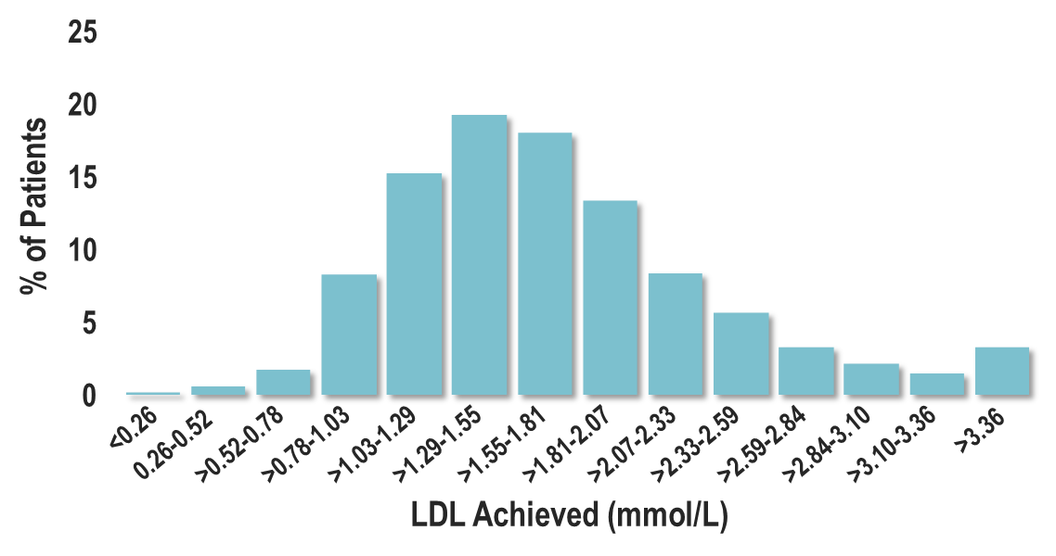
BUT … Not Everyone on an Intensive Statin Reaches LDL-C Threshold
Distribution of 4-month LDL-C levels Among Patients Treated with Intensive Statin Therapy (Atorvastatin 80 mg)
37% of patients with LDL-C ≥1.81 mmol/L
Wiviott et al for the PROVE IT-TIMI 22 Investigators J Am Coll Cardiol 2005;46:1411-16

Slide 25

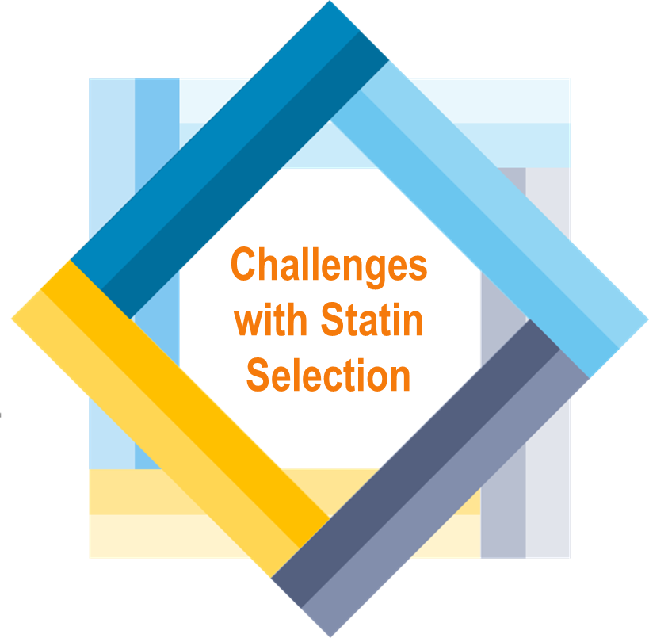
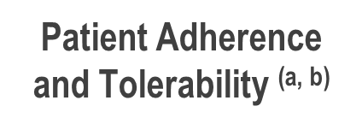
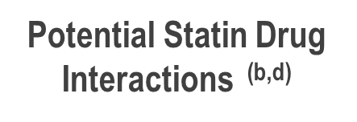

Multiple Challenges with Statin Selection
Ansell BJ. J Manag Care Pharm. 2008; 14 (suppl S-b): 29-S15;
Meade LT. US Pharm. 2007; 32:66-71;
Vogeli C, et al. J Gen Intern Med. 2007; 22(suppl 3): 391-395;
Ito M, et al. J Clin Lipidol. 2014;8:69-76

Slide 26
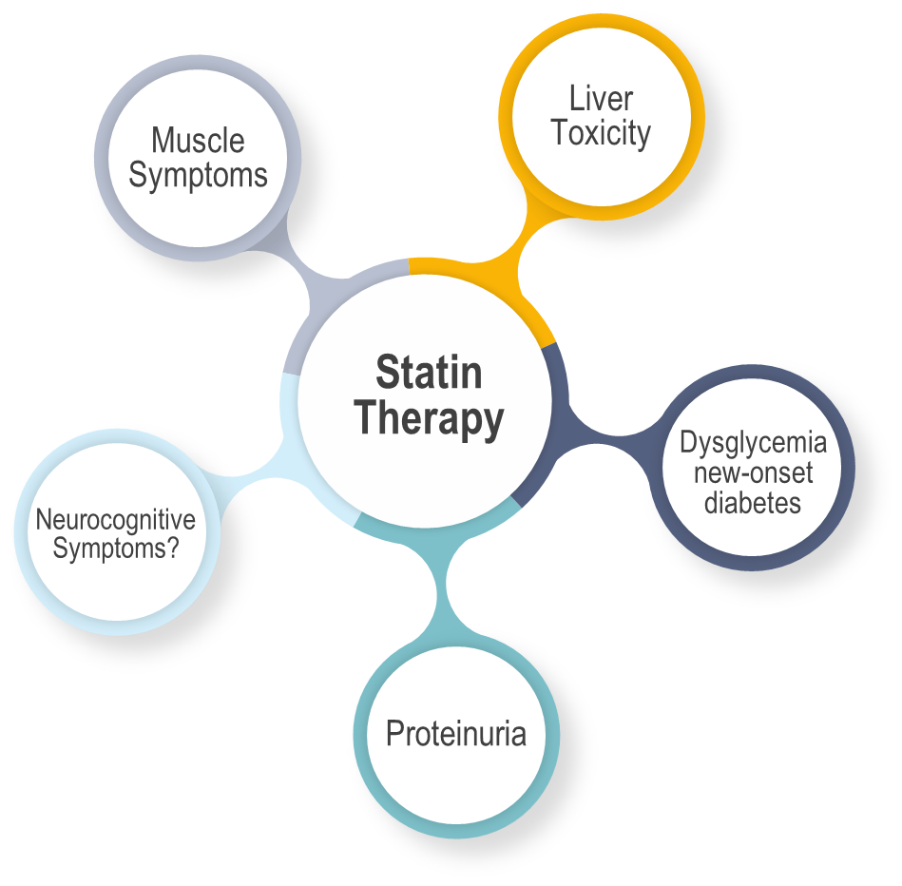
Adverse Effects Reported with Statin Therapy
Mach F, et al. Eur Heart J 2018; 39:2526-39

Slide 27
Impact of Statin-Associated Muscle Symptoms (SAMS)
Consequences of Low Statin Adherence: Increased CV Risk
Proportion of days covered with statin therapy (%) | Hazard ratio (95% CI) Primary Prevention | Hazard ratio (95% CI) Secondary Prevention
<10 | 1 (reference) | 1 (reference)
10-19 | 1.35 (1.22-1.50) | 1.28 (1.18-1.39)
50-59 | 0.77 (0.67-0.88) | 0.69 (0.63-0.76)
>90 | 0.55 (0.49-0.61) | 0.49 (0.46-0.53)
75% of patients discontinue statin within 2 years
SAMS is the prevailing reason in ~60% of patients
Chodick G et al. Clin Ther 2008;30:2167-79.
Cohen J et al. Clin Lipidol 2012;6:208-15
Shalev. Arch. Int Med 2009

Slide 28

Overall statin intolerance occurs in what
proportion of treated patients?
< 10%
10-15%
15-20%
>20%
Bruckert E et al. Cardiovasc Drugs Ther. 2005 ;19: 403–414
Notes:
Correct Answer: 2 (10-15%)

Slide 29
The Role of Non-Statin Therapies to Reduce ASCVD Events

Slide 30

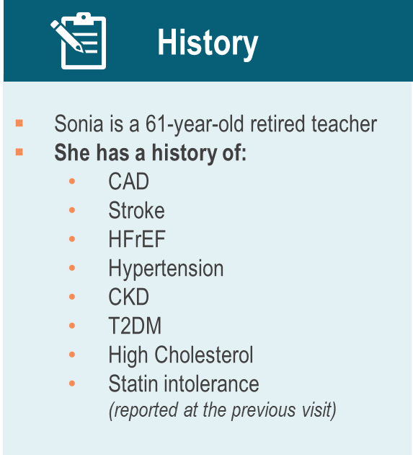
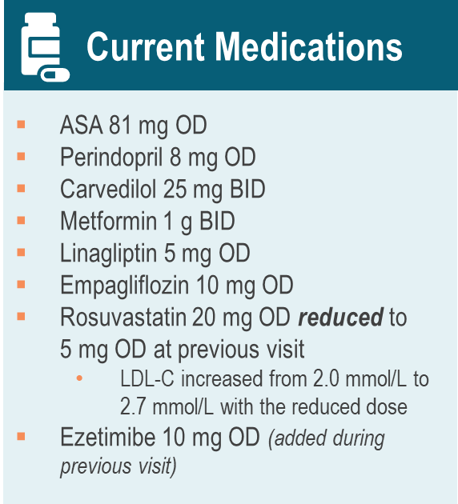
Case
Sonia

Slide 31
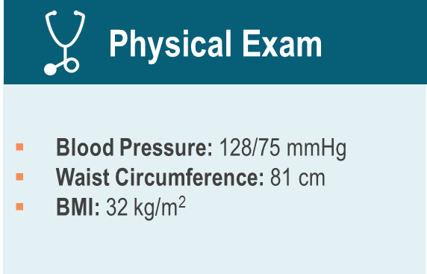
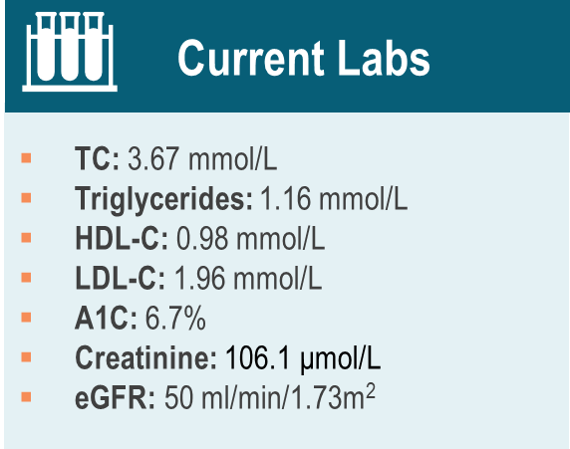
Case
Sonia

Slide 32

DISCUSSION
What is Sonia’s risk status?
How frequently do you manage patients with a similar clinical profile in your practice?

Slide 33
Which of the following steps would you undertake to further reduce Sonia’s risk for future ASCVD events during this visit?
Select ALL that Apply
Advise on appropriate health behaviour interventions
Change Rosuvastatin 5 mg OD to Atorvastatin 20 mg OD
Icosapent ethyl (IPE) 2 gm BID
Discuss initiation of a PCSK9 inhibitor
Notes:
1, 2 and 4 – correct response options.

Slide 34
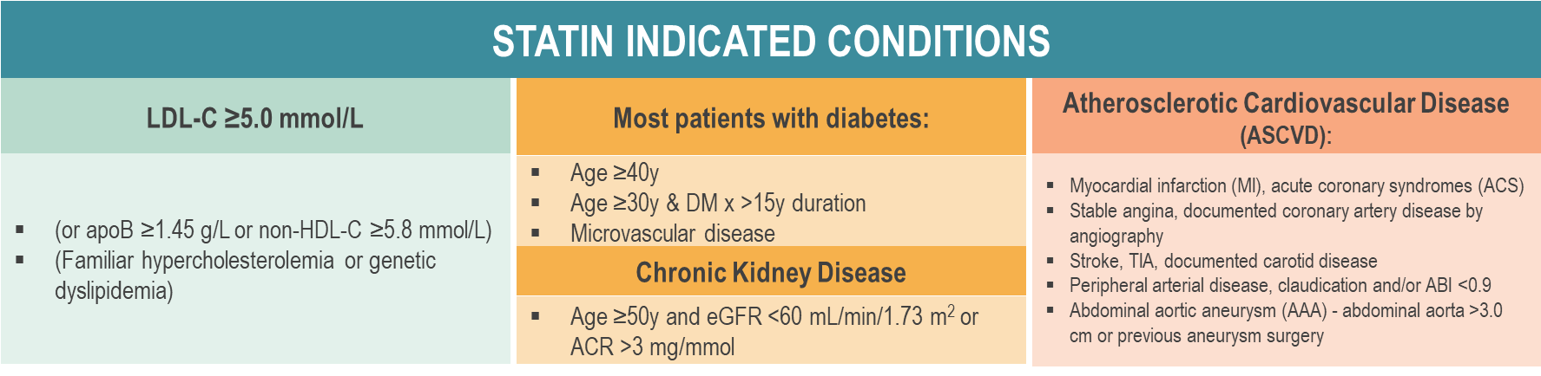
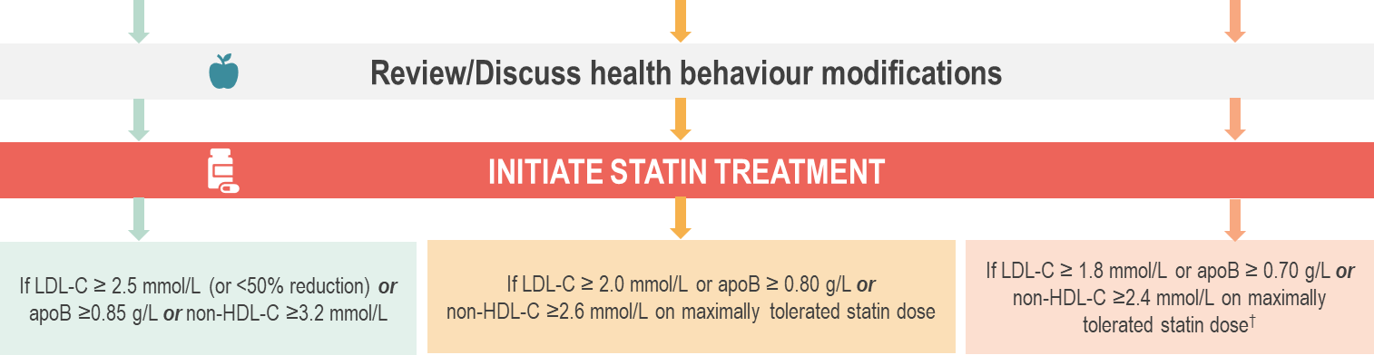
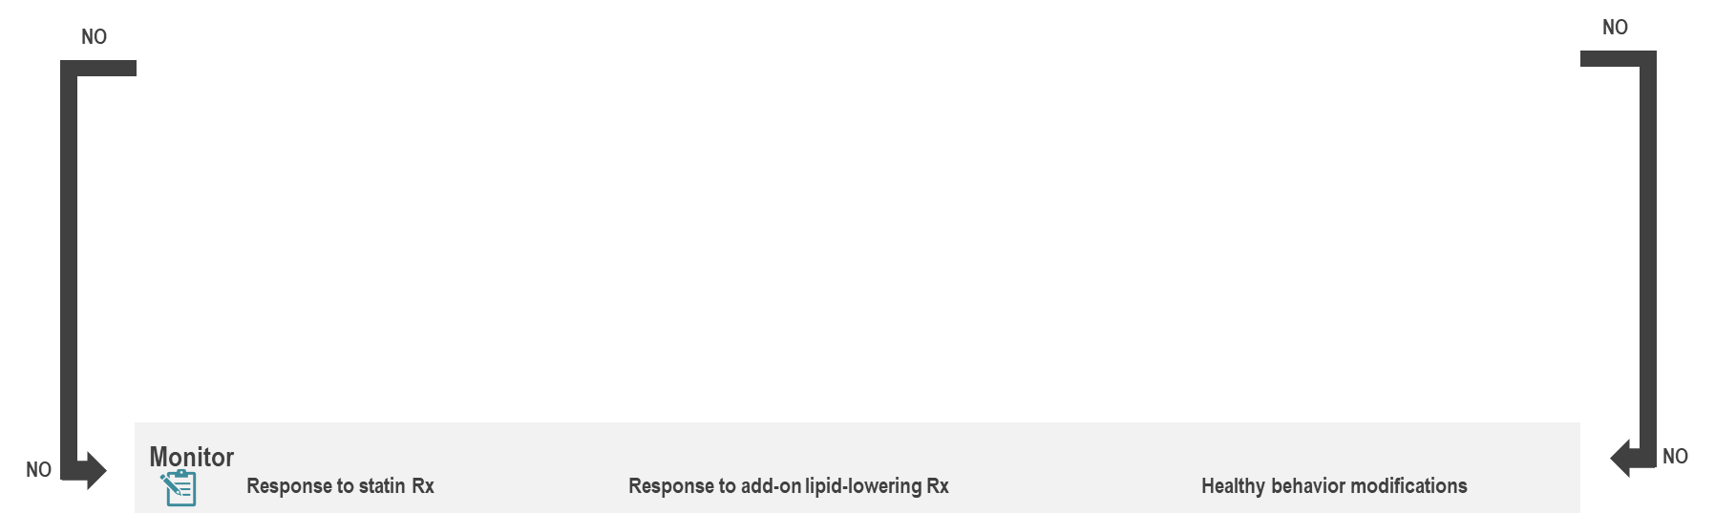
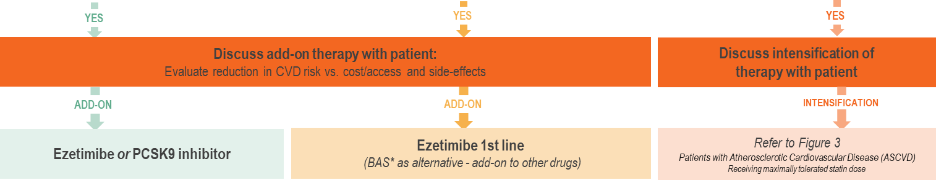
Treatment Approach for Patients with a
Statin Indicated Condition
NEW
Pearson GJ, et al. 2021 CCS Guidelines for the Management of Dyslipidemia for the Prevention of Cardiovascular Disease in the Adult. CJC. 2021;0(0). doi:10.1016/j.cjca.2021.03.016
Notes:
Figure 2. Treatment approach for patients with a statin-indicated condition. ABI, ankle-brachial index; ACR, albumin to creatinine; ApoB, apolipoprotein B; ASCVD, atherosclerotic cardiovascular disease; CVD, cardiovascular disease; HDL-C, high-density lipoprotein cholesterol; LDL-C, low-density lipoprotein cholesterol; PCSK9, proprotein convertase subtilisin/kexin type 9; Rx, treatment; TIA, transient ischemic attack.
Figure 3: Next Slide

Slide 35
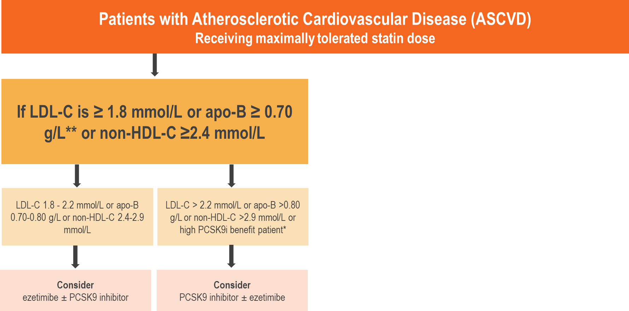
NEW
Treatment Intensification Approach for Patients with Atherosclerotic Cardiovascular Disease (ASCVD)
* Patients shown to derive the largest benefit from intensification of statin therapy with a PCSK9 inhibitor therapy are identified in table 3 (next slide)
** At low levels of LDL-C or non-HDL-C, measurement of apoB is more accurate with other markers.
Pearson GJ, et al. 2021 CCS Guidelines for the Management of Dyslipidemia for the Prevention of Cardiovascular Disease in the Adult. CJC. 2021;0(0). doi:10.1016/j.cjca.2021.03.016
Notes:
Figure 3. Treatment intensification approach for patients with atherosclerotic cardiovascular disease (ASCVD). ABI, ankle-brachial index; ApoB, apolipoprotein B; BP, blood pressure; CV, cardiovascular; DM, diabetes mellitus; eGFR, estimated glomerular filtration rate; HDL-C, high-density Q12 lipoprotein cholesterol; hsCRP, high-sensitivity C-reactive protein; LDL-C, low-density lipoprotein cholesterol; PCSK9i, proprotein convertase subtilisin/kexin type 9 inhibitor
Table 3: Next slide

Slide 36
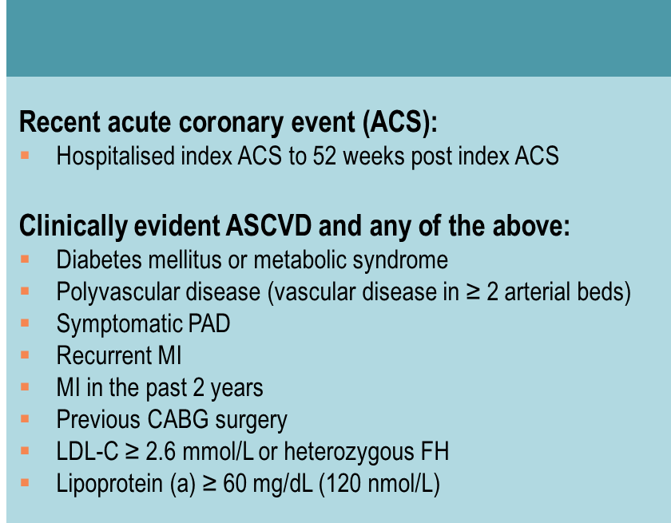
NEW
Secondary Prevention Patients Shown to Derive the Largest Benefit From Intensification of Statin Therapy with the Addition of a PCSK9 Inhibitor
Pearson GJ, et al. 2021 CCS Guidelines for the Management of Dyslipidemia for the Prevention of Cardiovascular Disease in the Adult. CJC. 2021;0(0). doi:10.1016/j.cjca.2021.03.016
Notes:
Table 3: Secondary Prevention Patients Shown to Derive the Largest Benefit From Intensification of Statin Therapy with the Addition of a PCSK9 Inhibitor

Slide 37
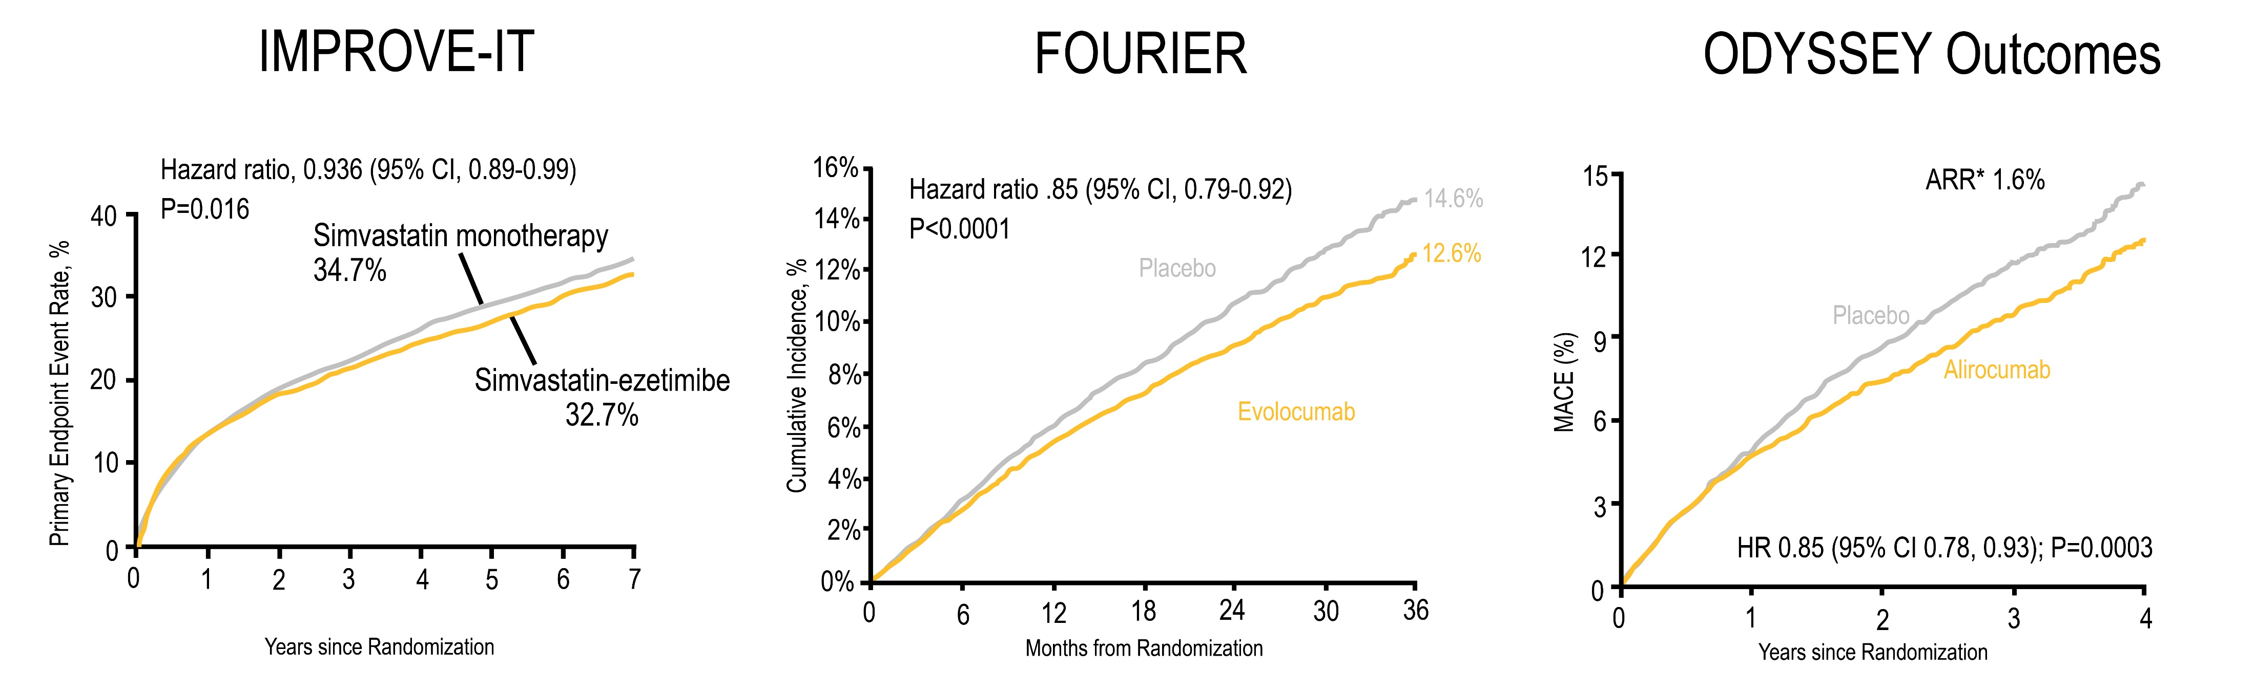
Non-Statin Strategies to Further Reduce LDL-C
Adding ezetimibe to statin therapy provides and additional LDL-C reduction of about 20% and 6% reduction in CV events
The data from clinical trials with PCSK9 inhibition demonstrate efficacy and safety of LDL-C lowering by an additional 60% on top of statin ± ezetimibe therapy resulting in further reductions in MACE. CV benefits are proportional to the absolute reduction in LDL-C and the duration of treatment
Cannon CP, et al. N Engl J Med. 2015;372:2387-2397
Sebatine MS, et al. N Engl J Med. 2017;376:1713-1722
Schwartz GG, et al. N Engl J Med. 2018:379:2097-2107

Slide 38
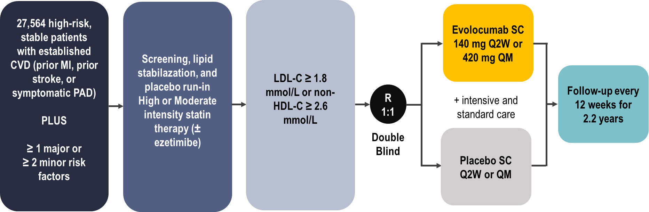
FOURIER Outcomes Trial
Evolocumab
Primary Efficacy Endpoint: composite of CV death, MI, stroke, hospitalization for UA, or coronary revascularization
Secondary Efficacy Endpoint: composite of CV death, MI, stroke
Sebatine MS, et al. N Engl J Med. 2017;376:1713-1722

Slide 39
ODYSSEY Outcomes Study
Alirocumab
18,924 patients with ACS within prior year, not stable ASCVD
2 to 16 weeks optimized atorvastatin/rosuvastatin
If LDL-C ≥ 1.8 mmol/L, non-HDL-C ≥ 2.6 mmol/L, or apoB ≥ 0.8 g/L patients were randomized to:
Alirocumab 75 mg every two weeks or placebo
Titration target: 0.6 to 1.3 mmol/L
If LDL-C ≥ 1.3 mmol/L → alirocumab uptitrated to 150 mg every 2 weeks
If LDL-C < 0.4 mmol/L → switched to placebo
Median follow-up 2.8 years
On-treatment LDL-C: alirocumab 1.4 mmol/L vs. placebo 2.6 mmol/L
Schwartz GG, et al. N Engl J Med. 2018:379:2097-2107

Slide 40
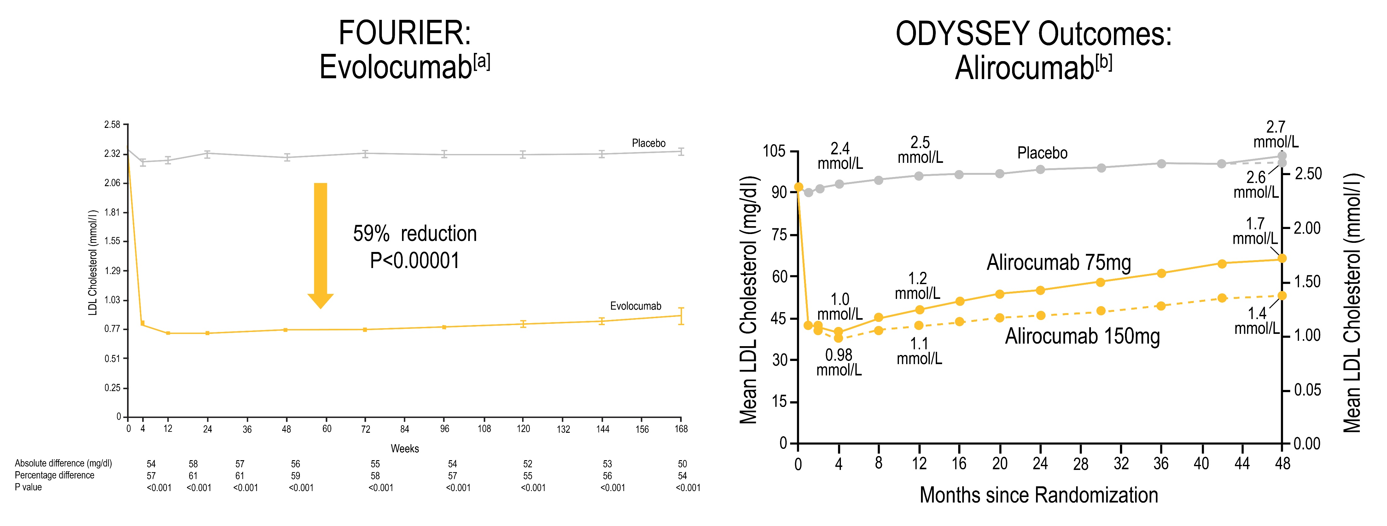
PCSK9 Inhibitors are Efficient at Lowering LDL-C
Change in LDL-C over time
Change in LDL-C over time
59% reduction
P <0.001
↓ LDL-C by 59%
↓ LDL-C by 55%
Sebatine MS, et al. N Engl J Med. 2017;376:1713-1722
Schwartz GG, et al. N Engl J Med. 2018:379:2097-2107

Slide 41
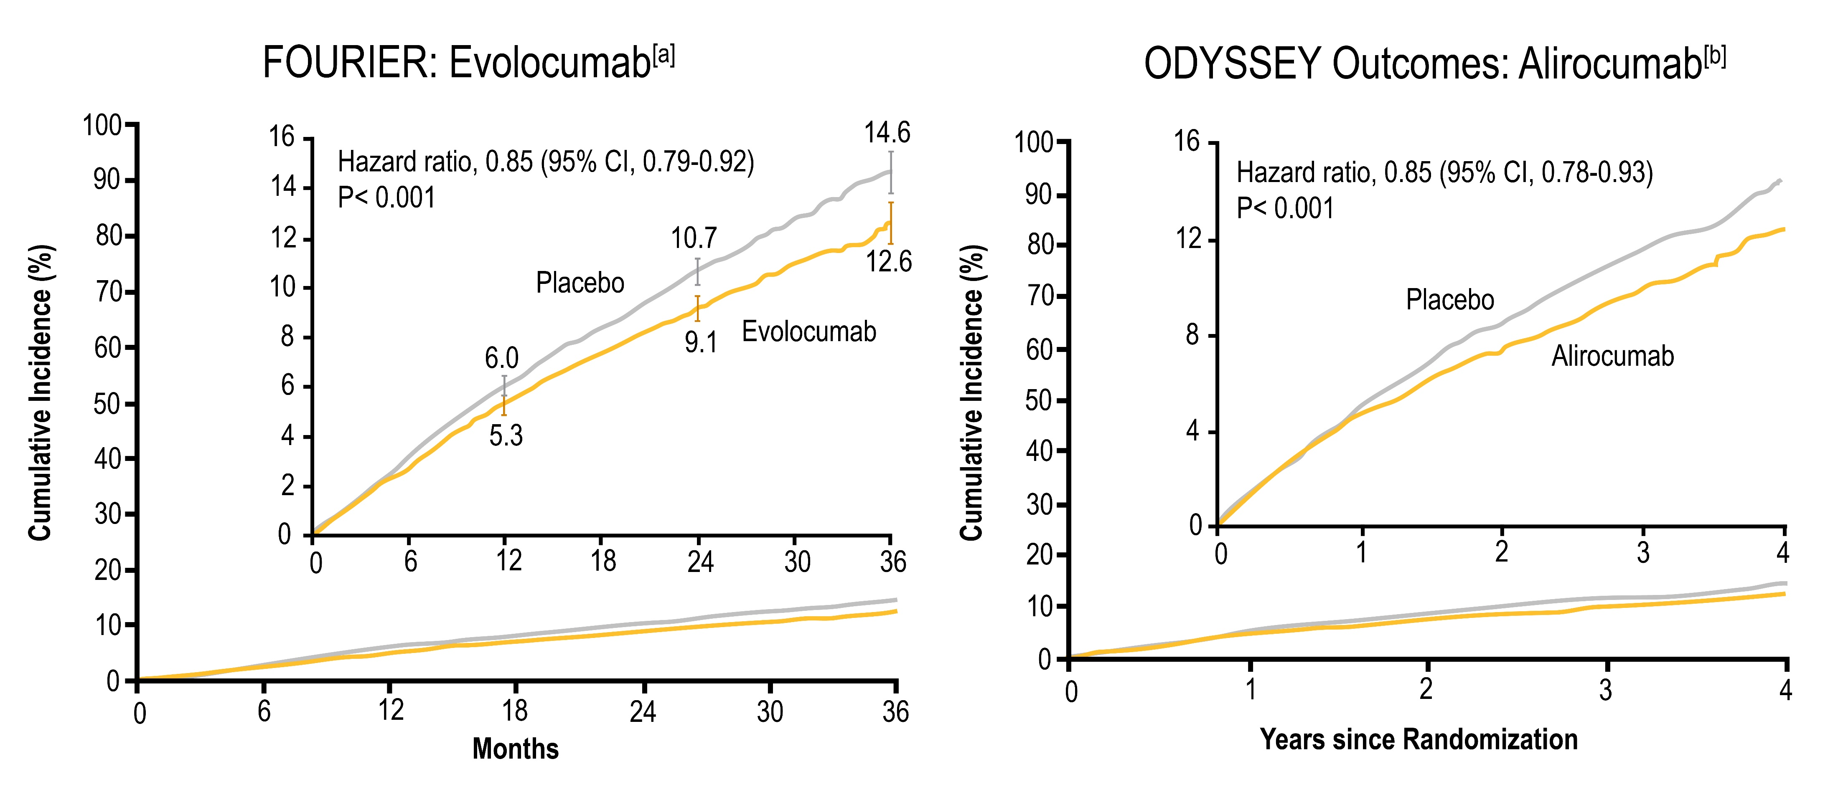
PCSK9 Inhibitors Reduce CV Events
MACE: CV death, MI, stroke, hospitalization for UA, or coronary revascularization
MACE: CHD death, nonfatal MI, ischemic stroke, or UA requiring hospitalization
Sebatine MS, et al. N Engl J Med. 2017;376:1713-1722
Schwartz GG, et al. N Engl J Med. 2018:379:2097-2107

Slide 42
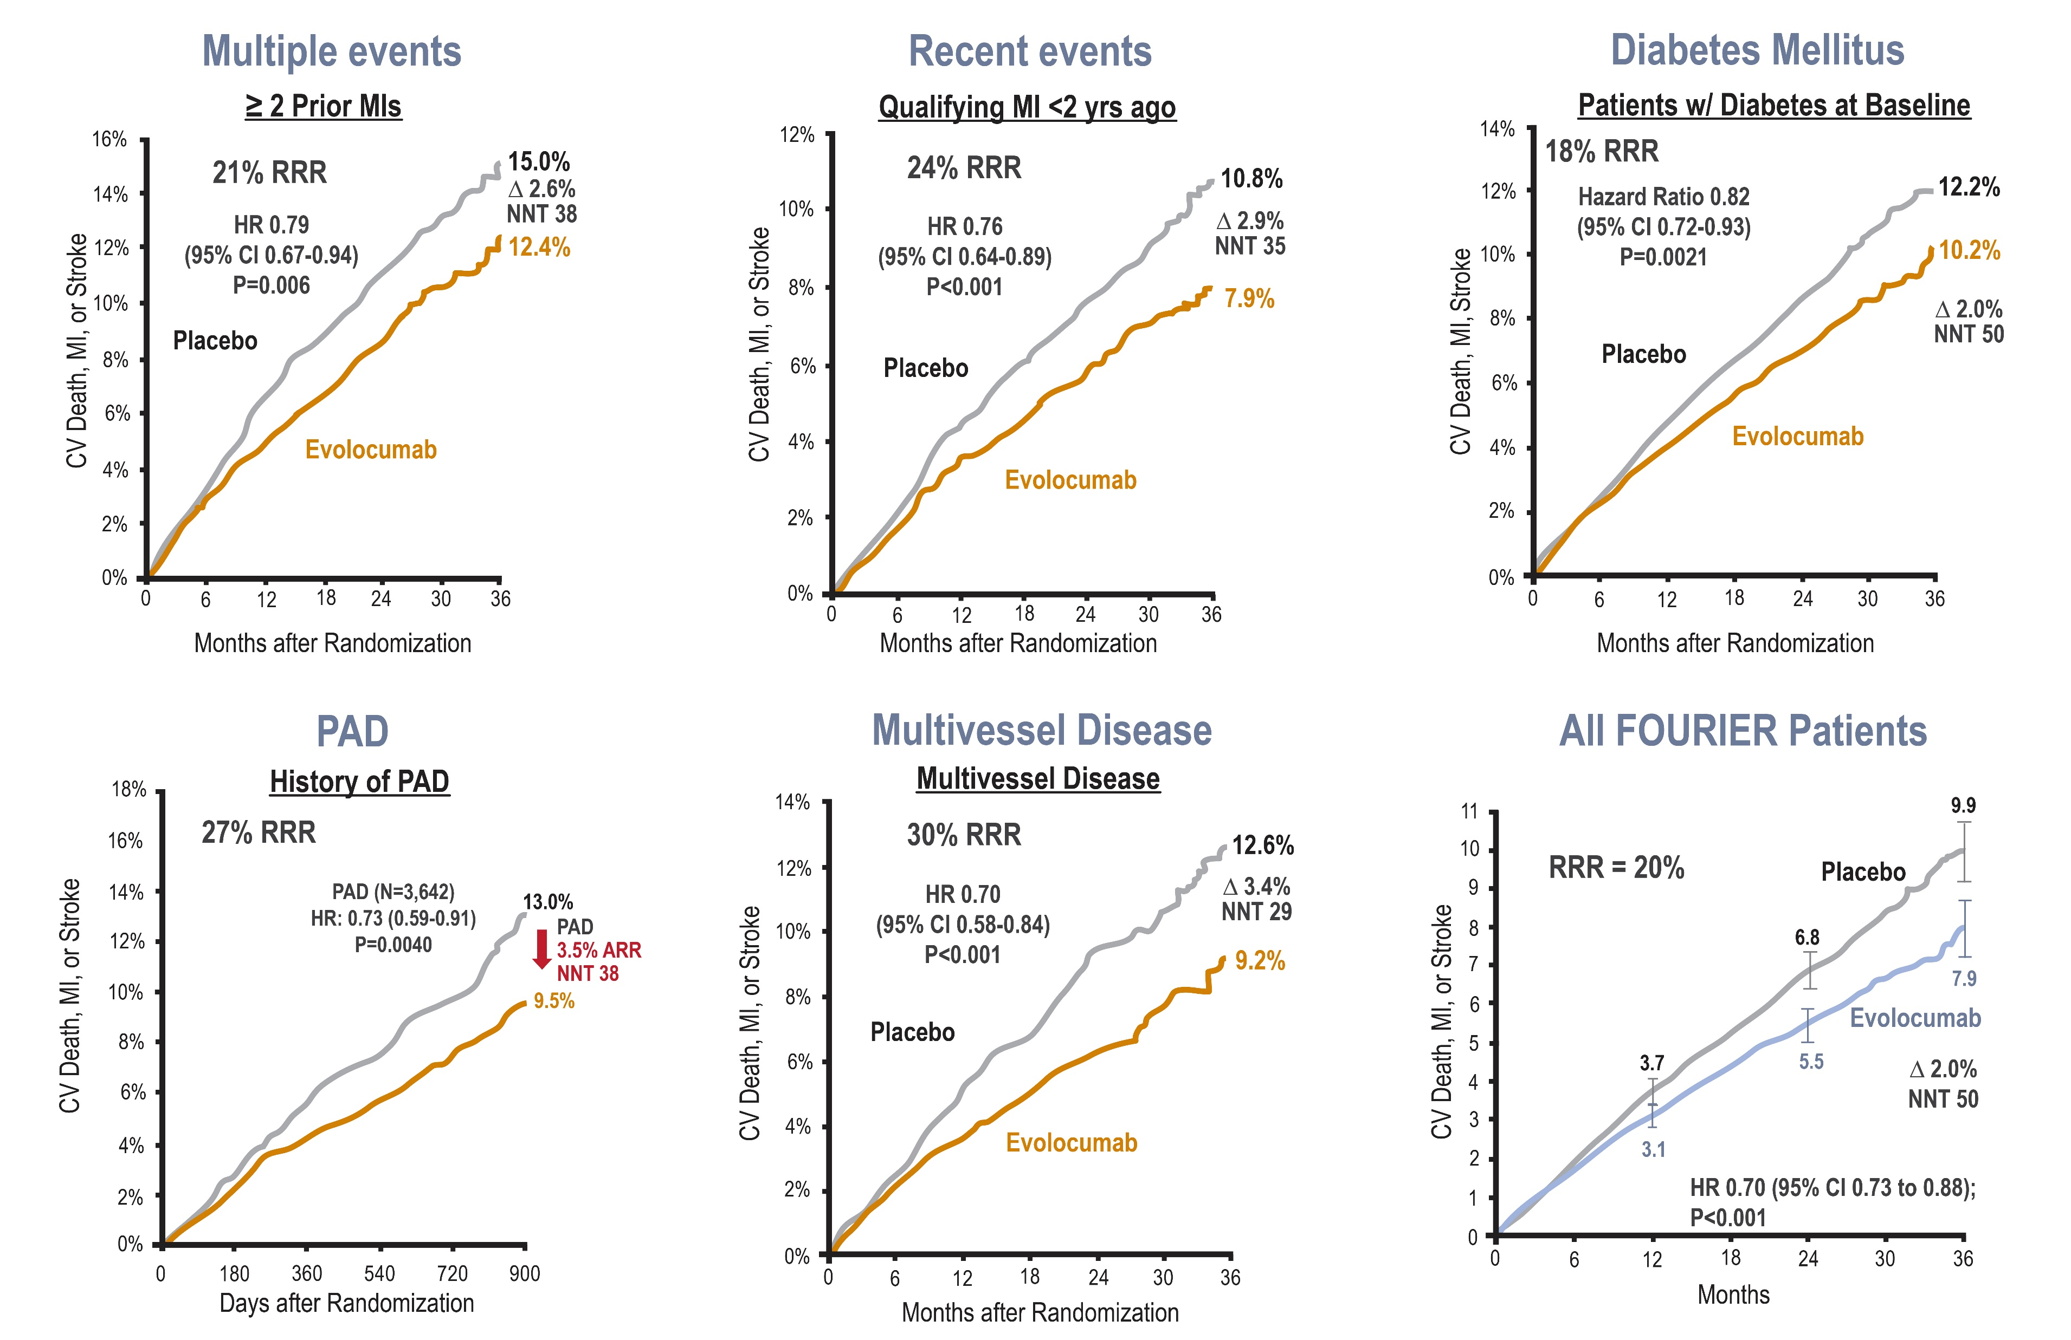
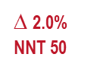
FOURIER Trial
Multiple High-Risk Patient Population Sub-Analysis
∆ 2.6% NNT 38
∆ 2.9% NNT 35
∆ 2.0% NNT 50
PAD
3.5% ARR
NNT 29
∆ 3.4% NNT 29
HR 0.80 (95% CI 0.73 to 0.88);
P<0.001
Sabatine MS, et al . AHA 2017 Poster

Slide 43
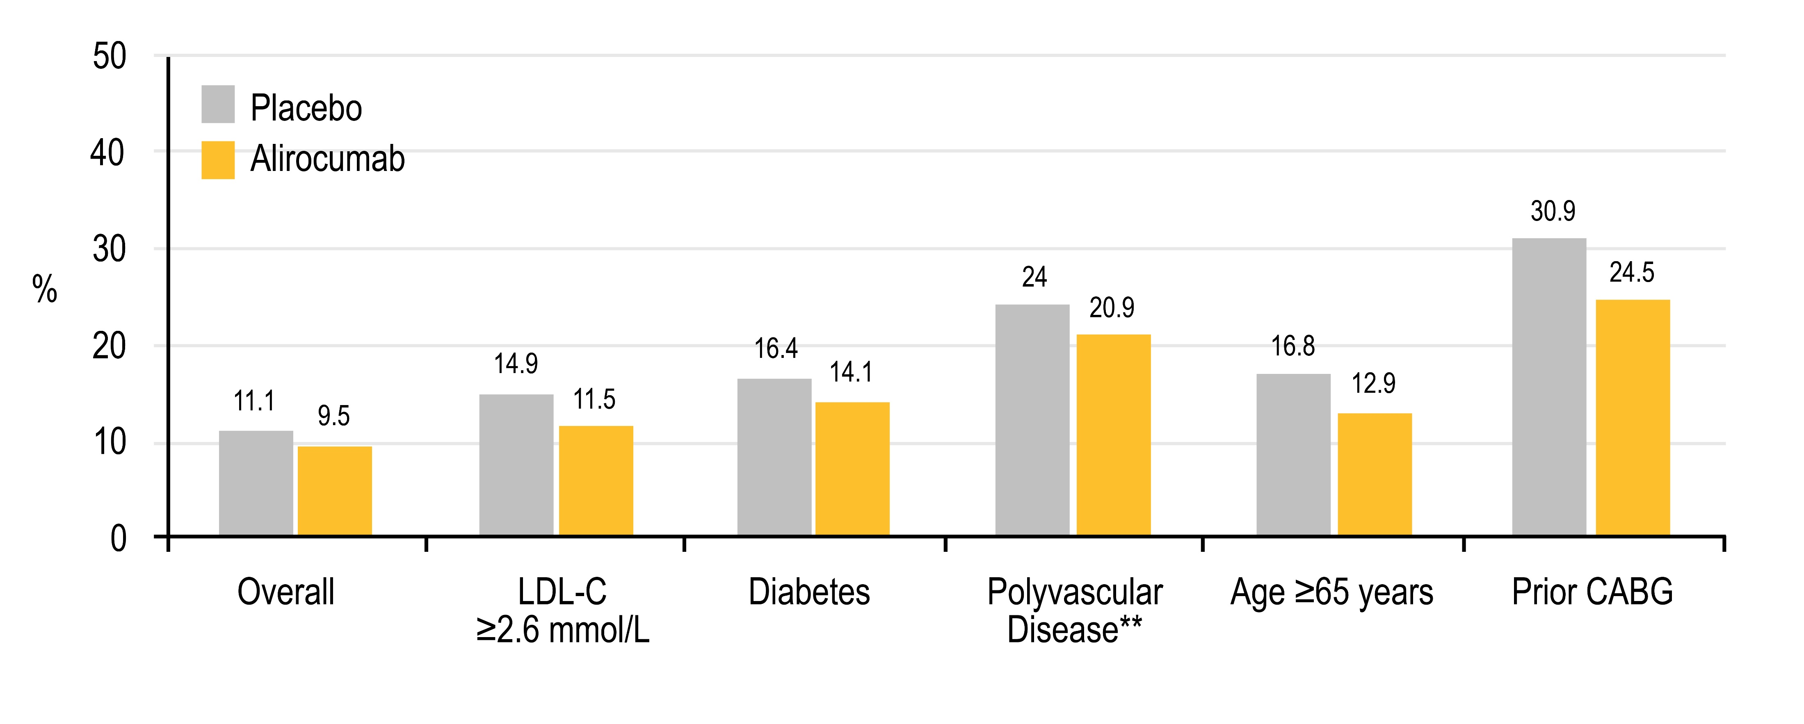
Benefit of Alirocumab in High-Risk Patients
CHD death, non-fatal MI, ischemic stroke, or unstable angina requiring hospitalization*
6.4% ARR*
NNT~16
3.9% ARR*
NNT~26
3.1% ARR*
NNT~32
3.4% ARR*
NNT~29
2.3% ARR*
NNT~44
1.6% ARR*
NNT~63
15% RRR
24% RRR
16% RRR
14% RRR
14% RRR
23% RRR
*Based on cumulative incidence or 3-year KM estimates
**CAD + PAD ± CeVD
Adapted from Schwartz et al N Engl J Med 2018;379:2097-107; Ray et al Lancet Diabetes Endocrinol 2019;2019;7:618-28; Jukema et al J Am Coll Cardiol 2019;74:1167-76; Sinnaeve et al Eur Heart J 2020;41:2248-58; Goodman et al J Am Coll Cardiol 2019;74:1177–86

Slide 44
NEW
When and How to Intensify LDL-C Lowering Therapies
Intensification of LDL-C- lowering therapy in clinical ASCVD
(in addition to maximally tolerated statins )
Sonia
Intensification of lipid-lowering therapy with ezetimibe and/or PCSK9 inhibitor therapy for all secondary prevention CVD patients in whom LDL-C remains ≥ 1.8 mmol/L (or non-HDL-C ≥ 2.4 mmol/L or ApoB ≥ 0.7 g/L) on maximally tolerated statin dose is recommended. If ezetimibe is used initially and LDL-C remains ≥ 1.8 mmol/L (or non-HDL-C ≥ 2.4 mmol/L or ApoB ≥ 0.7 g/L) PCSK9 inhibitor therapy is recommended. (Strong recommendation; High Quality Evidence).
Sonia is on a maximally tolerated statin dose (Rosuvastatin 5 mg OD) &
Ezetimibe 10 mg OD
Pearson et al. 2021 Canadian Cardiovascular Society Guidelines for the Management of Dyslipidemia for the Prevention of Cardiovascular Disease in the Adult. From: https://doi.org/10.1016/j.cjca.2021.03.016
Wiviott et al for the PROVE IT-TIMI 22 Investigators J Am Coll Cardiol 2005;46:1411-16

Slide 45
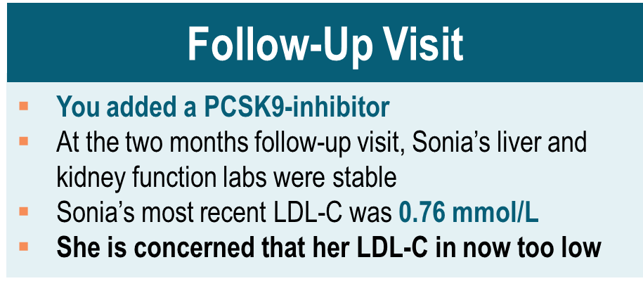
Case
Sonia

Slide 46
Sonia’s LDL-C is 0.76 mmol/L and she is concerned that it is too low. What are your next steps?
Stop the statin
Stop the ezetimibe
Stop the PCSK9 inhibitor
Continue all her lipid-lowering medications
Notes:
Correct Answer 4

Slide 47
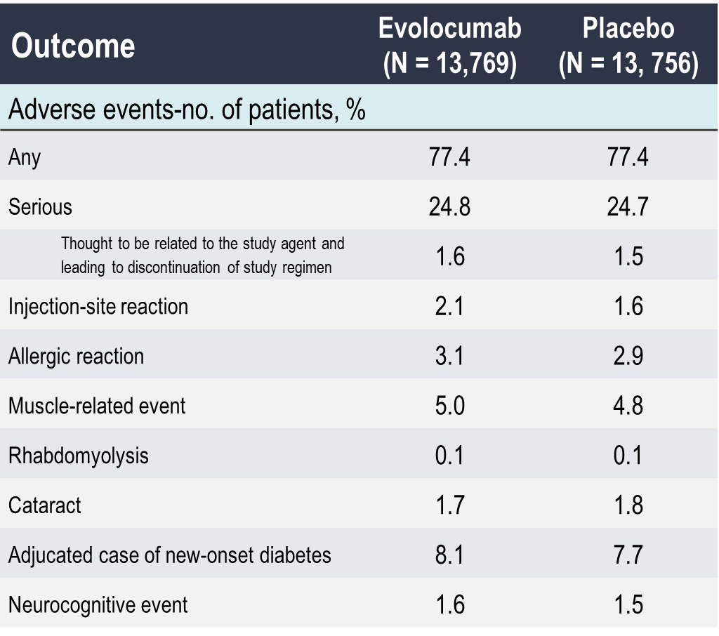
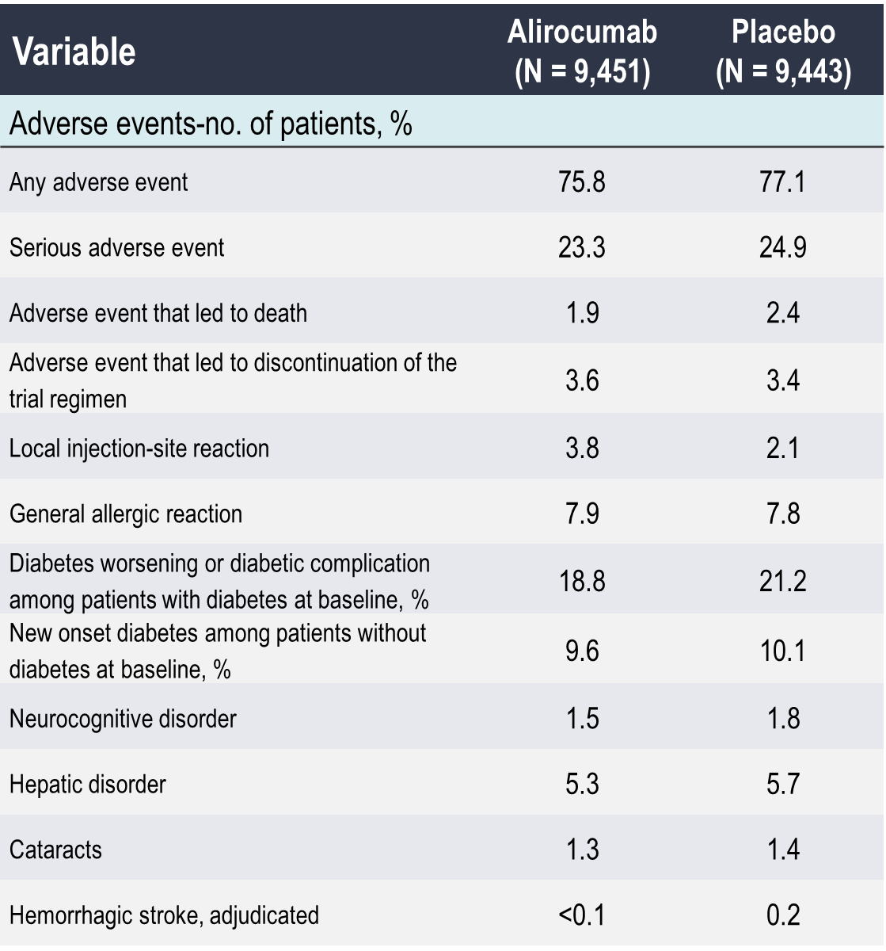
PCSK9 Inhibitors are Safe
FOURIER: Evolocumab^{(a)}
ODYSSEY Outcomes: Alirocumab^{(b)}
Sebatine MS, et al. N Engl J Med. 2017;376:1713-1722
Schwartz GG, et al. N Engl J Med. 2018:379:2097-2107
Notes:
Injection site reactions the only AEs worth noting with both agents

Slide 48
In the FOURIER Trial, Even at Very Low LDL-C < 0.5 mmol/L Safety Parameters Were Similar Across Achieved LDL-C Levels
Safety Events by Achieved LDL-C Concentration 4 Weeks After Randomization
P = NS
P = NS
P = NS
P = NS
P = NS
P = NS
P = NS
P = NS
P = NS
P = NS
LDL-C, mg/dL (mmol/L) at 4 weeks
A secondary analysis of 25,982 patients from the FOURIER trial explored the association between LDL-C concentration at 4 weeks and prespecified safety events over a median of 2.2 years of follow-up
AE, adverse event; ALT, alanine aminotransferase; AST, aspartate aminotransferase; CK, creatine kinase; CV, cardiovascular; Discon, discontinued; DM, diabetes mellitus; FOURIER, Further Cardiovascular Outcomes Research with PCSK9 Inhibition in Subjects With Elevated Risk; Hem, hemorrhagic; LDL-C, low-density lipoprotein cholesterol; Neurocog, neurocognitive; NS, not significant; SAE, serious adverse event.
Giugliano RP, et al. Lancet. 2017;390:1962-1971.

Slide 49
Achievement of Ultra-low LDL-C Levels in FOURIER Further Reduced the Risk of Major CV Events
Primary Endpoint (Composite of CV Death, MI, Stroke, Coronary Revascularization, Hospitalization for UA)
Secondary endpoint (Composite of CV death, MI, Stroke)
HR: 0.69 (0.49–0.97)
P* = 0.0354
HR: 0.59 (0.37–0.92)
P* = 0.0203
HR: 0.71 (0.56–0.89)
P* = 0.0031
HR: 0.66 (0.50–0.88)
P* = 0.0049
Major CV events progressively declined with lower achieved LDL-C at week 4
*P value compared with the group achieving an LDL-C ≥ 100 mg/dL (≥ 2.6 mmol/L) at 4 weeks.
CV, cardiovascular; HR, hazard ratio; LDL-C, low-density lipoprotein cholesterol; MI, myocardial infarction; UA, unstable angina.
Giugliano RP, et al. Lancet. 2017;390:1962-1971.

Slide 50
Overcoming Access Barriers to PCSK9 Inhibitors
01
Fill in the requisite information appropriately to get reimbursement for our patients
02
Documentation of LDL-C history and possible statin intolerance
03
Documentation of high-risk features and co-morbidities
Baum SJ, et al. Clin Cardiol. 2017;40:243-254

Slide 51
Strategies for Lipid Guideline Implementation
Keep medication regimens simple and provide clear instructions to the patient.
Promote adherence and involve family / care-giver support when applicable.
Lower medication barriers and assess adherence often.
Embed decision support tools into electronic medical records and use technology to identify high-risk patients not receiving appropriate therapy or meeting thresholds.
Shared decision making and communication is critical to adherence to lifestyle and drug therapy along with follow-up lipids.
Communicate the essential nature of a risk decision involving the evidence, patient characteristics, clinician judgment and after hearing about benefits, risks, and options, the inclusion of patient preference in shared decision-making.
Adapted from: http://jaccjacc.acc.org/Clinical_Document/Cholesterol_GL_Web_Supplement.pdf
Grundy SM, et al. Circulation 2019;139(25):e1082-e1143

Slide 52
Secondary Prevention Patients Shown to Derive the Largest Benefit from Intensification of Statin Therapy with the Addition of a PCSK9 Inhibitor

Slide 53

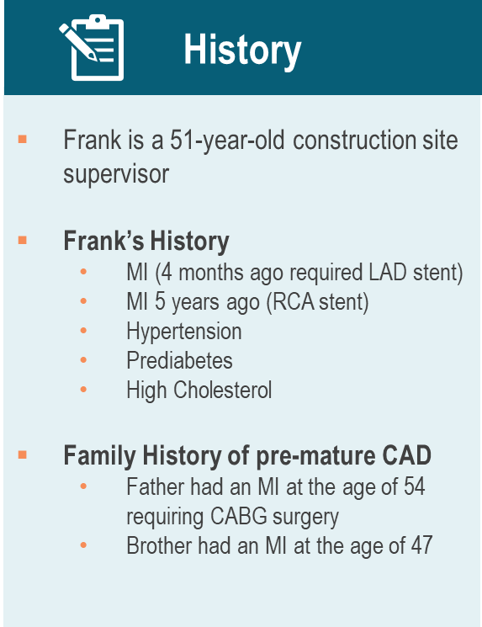
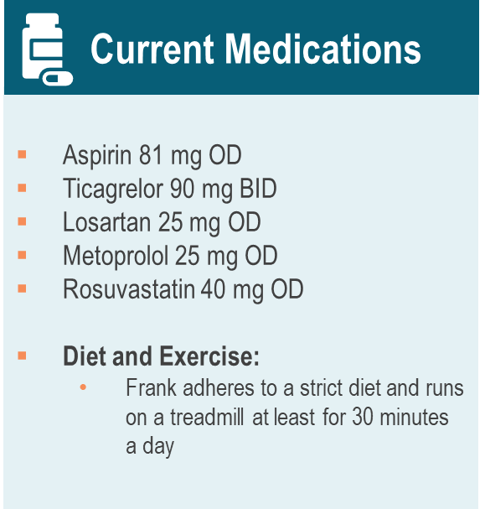
Case
Frank

Slide 54


Case
Frank

Slide 55
DISCUSSION
How frequently do you manage patients with a similar clinical profile in your practice?
Notes:
Discuss co-management with specialists

Slide 56
Which medication would provide Frank with the highest absolute risk reduction?
Ezetimibe 10 mg OD
PCSK9 inhibitor
Niacin 1000 mg OD
Colesevelam 3.75 gm BID
Notes:
Correct Answer is 2

Slide 57
NEW
Secondary Prevention Patients Shown to Derive the Largest Benefit from Intensification of Statin Therapy with the Addition of a
PCSK9 Inhibitor
Frank
Intensification of lipid-lowering therapy with a PCSK9 inhibitor (evolocumab or alirocumab) – with or without the addition of ezetimibe – for secondary CV prevention patients shown to derive the largest benefit from PSCK9 inhibitor therapy in whom LDL-C remains ≥ 1.8 mmol/L (or non-HDL-C ≥ 2.4 mmol/L or ApoB ≥ 0.7 g/L) is recommended
on maximally tolerated statin dose.
(Strong Recommendation; Moderate-Quality Evidence)
Pearson GJ, et al. 2021 CCS Guidelines for the Management of Dyslipidemia for the Prevention of Cardiovascular Disease in the Adult. CJC. 2021;0(0). doi:10.1016/j.cjca.2021.03.016
Notes:
ACS, acute coronary syndrome; ASCVD, atherosclerotic cardiovascular disease; CABG, coronary artery bypass graft; FH, familial hypercholesterolemia; LDL-C, low density lipoprotein cholesterol; MI, myocardial infarction; PAD, peripheral arterial disease; PCSK9, proprotein convertase subtilisin/ kexin type 9

Slide 58

Benefit of Evolocumab in High-Risk MI Subgroups
N=22,351 with Prior MI → median ~3 (1, 7) yrs ago
MI patients with ≥1 High-Risk Feature:
Estimated ARR_{5 years}=5% or NNT_{5 years}~20
Sabatine et al Circulation 2018;138:756-66

Slide 59
In a FOURIER Sub Analysis, Patients Treated with Evolocumab within 1 Year of Their Most Recent MI, Demonstrated a 25% Risk Reduction
Key Secondary Endpoint
(Composite of CV Death, MI, or Stroke)
Placebo + statin
Evolocumab + statin
(N = 5,711 with a recent MI ≤ 12 months)
10.9%
3-Year KM Event Rate
7.7%
For recent MI: ARR = 3.2%
NNT_{3y} = 31
Analysis Time (Days)
Remote MI is > 12 months; ARR = 1.3%. Patients received statin background therapy with 77% in the recent MI group and 69% in the remote MI group on high-intensity statins.
ARR = absolute risk reduction; CI = confidence interval; CV = cardiovascular; HR = hazard ratio; KM = Kaplan-Meier; MI = myocardial infarction.
Gencer B, et al. JAMA Cardiol. 2020 doi: 10.1001/jamacardio.2020.0882.

Slide 60

In an Odyssey Sub-Analysis, Patients with Recent ACS, a Previous History of MI were Associated with Greater CV Risk and Greater Absolute Risk Reduction with Alirocumab Treatment.
Chern-En Chiang et al. J Am Coll Cardiol 2021; 77:8-8.
Notes:
Background
In the ODYSSEY OUTCOMES randomized trial, the PCSK9 inhibitor alirocumab reduced major adverse cardiovascular (CV) events (MACE) and was associated with fewer deaths compared to placebo in patients with recent acute coronary syndrome (ACS). We determined if the benefit of alirocumab was influenced by a history of myocardial infarction (MI) prior to the qualifying ACS.
Methods
The primary MACE outcome was coronary heart disease death, MI, ischemic stroke or unstable angina requiring hospitalization. All-cause death was a secondary outcome.
Results
Compared to patients without previous MI (n=15,291), patients with previous MI (n=3,633) were older, had more CV risk factors, and were more likely to be male and to have had other types of CV events. Placebo-treated patients with previous MI had a higher risk of MACE (adjusted hazard ratio [aHR] 1.85, 95% CI 1.62-2.11; P<0.001) and all-cause death (aHR 1.56, 1.25-1.95; P<0.001) vs those without previous MI. In patients with vs without prior MI, alirocumab had a consistent relative effect on MACE (aHR 0.90, 0.78-1.05 and 0.82, 0.73-0.92; P_{int}=0.34) and all-cause death (aHR 0.84, 0.64-1.08 and 0.87, 0.72-1.05, P_{int}=0.81; Fig.). Absolute risk reductions with alirocumab were 1.91% and 1.42% (number needed to treat: 53 and 71) for MACE and 1.35% and 0.41% (75 and 244) for all-cause death.
Conclusion
In patients with recent ACS, a previous history of MI was associated with greater CV risk and greater absolute risk reduction with alirocumab treatment.

Slide 61
Case
Frank
Follow-Up Visit
You added a PCSK9-inhibitor
Re-emphasize the benefit of Frank’s adherence to healthy lifestyle choices.
Frank’s most recent LDL-C was 0.7 mmol/L
Patients with a recent MI are at a higher risk of CV events and show greater ARRs with PCSK9 inhibitors than those with a more remote MI.
Patients with a recent MI have a higher baseline risk and experience similar relative risk reduction with PCSK9 inhibitors.
These findings support the overall concept in the 2021. Dyslipidemia Guidelines to aggressively lower LDL-C levels in very high-risk patients such as those with a recent MI.
ARR: Absolute Risk Reduction
Notes:
Utilize the Electronic Medical Platform to highlight patients with a recent MI and utilize tools / apps to address and keep track of other risk factors (e.g. glucose, blood pressure etc…).
Ongoing reassessment of patient status and measurements of adherence, LDL-C etc…
Co-management with specialists and other HCPs

Slide 62
Secondary Prevention:
New Key Take-Aways from the 2021 Guidelines
LDL-C threshold of 1.8 mmol/L for intensification of lipid-lowering therapy with non-statin drugs in secondary prevention is emphasized.
In very high-risk patients with LDL-C ≥1.8 mmol/L, intensification with PCSK9 Inhibitor is especially recommended with or without ezetimibe. Table 3 (Secondary Prevention Patients Shown to Derive the Largest Benefit from Intensification of Statin Therapy with the Addition of a PCSK9 Inhibitor) of the guidelines elaborates on the groups of very high-risk patients.
For rest of the patients with ASCVD, ezetimibe is recommended first, unless the patient has LDL-C >2.2 mmol/L when “it may be preferable to consider a PCSK9i as second line therapy” (i.e. after statin).
Additional lipid-lowering therapy with ezetimibe and PCSK9i may also be considered for ASCVD patients with an LDL-C <1.8 mmol, especially for patients considered to be at high risk for recurrent ASCVD events.
No risk at very low LDL-C so no need for lipid-lowering therapy de-intensification (low LDL-C is safe).
Pearson GJ, et al. 2021 CCS Guidelines for the Management of Dyslipidemia for the Prevention of Cardiovascular Disease in the Adult. CJC. 2021;0(0). doi:10.1016/j.cjca.2021.03.016
Notes:
ASCVD, atherosclerotic cardiovascular disease; LDL-C, low-density lipoprotein cholesterol.

Slide 63
Program Summary
In patients at risk for CV events, LDL-C reduction remains the top priority.
LDL-C is the most modifiable risk factor in CV risk, and failure to attain guideline-recommended LDL-C thresholds is a key component of continued risk.
Lower thresholds for treatment intensification have now been recommended and therefore additional LDL-C lowering options are needed.
The data from clinical trials with PCSK9 inhibitors demonstrate efficacy and safety of LDL-C lowering by an additional 60% on top of statin ± ezetimibe therapy resulting in further reductions in MACE.
Pearson GJ, et al. 2021 CCS Guidelines for the Management of Dyslipidemia for the Prevention of Cardiovascular Disease in the Adult. CJC. 2021;0(0). doi:10.1016/j.cjca.2021.03.016

Slide 64
Q&A and DISCUSSION
Notes:
Key Take-Aways
Q&A

Slide 65
BACK-UP SLIDES

Slide 66
Coronary Artery Calcium Scoring (CAC):
CAC adds to risk prediction beyond FRS
Coronary artery calcium testing is useful in diagnosing subclinical coronary artery disease and in predicting the risk of future cardiovascular events and death.
Given the high negative predictive value of the test, it can also serve to reclassify risk in patients beyond traditional risk factors. CAC adds to risk prediction beyond FRS.
Along with shared decision-making, elevated calcium scores can guide the initiation of statin or aspirin therapy.
Repeat CAC testing is not recommended.
How to interpret CAC
CAC = 0 (true normal) has a negative predictive value in low -risk adults of 95-99% over 2-5 years, event rate of 1.5% over 10 years (not a zero rate of events).
CAC > 0 confirms presence of atherosclerotic plaque, and increasing scores are directly proportional to increased risk.
CAC > 100 is associated with high risk (>2% annual risk).
Even if CAC = 0, patients with strong family history, poorly controlled risk factors, Familial Hypercholesterolemia (FH) or elevated Lp(a) still warrant consideration of treatment.
Parth P. et al; Cleveland Clinic Journal of Medicine September 2018, 85 (9) 707-716; DOI: https://doi.org/10.3949/ccjm.85a.17097
Notes:
Back Up Slide – Primary Prevention: CAC

Slide 67

CAC Impact on Risk Stratification Beyond FRS
Can Reclassify ASCVD Risk Between 7.5 – 19.9%
* After risk discussion
Modified from: Greenland P et al JACC 2018: 72(4): 434 - 47
Notes:
BACK-UP slide CAC
CAC screening using computed tomography imaging may be considered for asymptomatic adults ≥ 40 years and at intermediate risk (FRS 10%- 20%) for whom treatment decisions are uncertain is suggested. (Strong Recommendation, Moderate-Quality Evidence)
CAC screening using computed tomography imaging not be undertaken for: (1) high-risk individuals; (2) patients receiving statin treatment; or (3) most asymptomatic, low-risk adults. (Strong Recommendation; Moderate-Quality Evidence)
CAC screening may be considered for a subset of lowrisk individuals > 40 years with a family history of premature ASCVD (men < 55 years; women ≤†65 years) in addition to identifying known genetic causes of CAD such as elevated Lp(a) or FH is suggested. (Weak Recommendation; Low-Quality Evidence)
Lab Testing in Canada
CAC testing is not uniformly available or uniformly funded in Canada at this time

Slide 68
NEW
CAC and the Decision to Treat
CAC screening using computed tomography imaging may be considered for asymptomatic adults ≥ 40 years and at intermediate risk (FRS 10%- 20%) for whom treatment decisions are uncertain is suggested. (Strong Recommendation, Moderate-Quality Evidence)
CAC screening using computed tomography imaging not be undertaken for: (1) high-risk individuals; (2) patients receiving statin treatment; or (3) most asymptomatic, low-risk adults. (Strong Recommendation; Moderate-Quality Evidence)
CAC screening may be considered for a subset of low-risk individuals > 40 years with a family history of premature ASCVD (men < 55 years; women ≤†65 years) in addition to identifying known genetic causes of CAD such as elevated Lp(a) or FH is suggested. (Weak Recommendation; Low-Quality Evidence)
Lab Testing in Canada
CAC testing is not uniformly available or uniformly funded in Canada at this time
ASCVD, atherosclerotic cardiovascular disease; AU, Agatston units; CAC, coronary artery calcium; CV, cardiovascular; FH, familial hypercholesterolemia; FRS, Framingham Risk Score; Lp(a), lipoprotein a; MI, myocardial infarction; RCTs, randomized control trials. Pearson et al. 2021 Canadian Cardiovascular Society Guidelines for the Management of Dyslipidemia for the Prevention of Cardiovascular Disease in the Adult. From: https://doi.org/10.1016/j.cjca.2021.03.016
Notes:
Back Up Slide – Primary Prevention: CAC
Typical ASCVD event risk algorithms (e.g. FRS) can lead to substantial over- or underestimation of ASCVD event risk ⁶³, and consequently, inappropriate risk factor management. Additionally, the value of these algorithms for predicting the presence and burden of atheroma is poor. The literature is replete with clinical studies reinforcing the concept that directly assessing the presence of atheroma, through CAC, significantly improves the appropriate selection of patients who are likely to benefit from lipid modifying therapy.
Non-contrast, CAC measurements are sensitive, reproducible, and can be performed rapidly with an average radiation dose of 0.89 mSv (compared to background annual radiation exposure of approximately 3.0 mSv).
A CAC measurement > 0 Agatston units (AU) confirms the presence of atherosclerotic plaque. Increasing scores are directly proportional to increased ASCVD event risk.⁷¹⁻⁷⁴ A CAC measurement > 100 AU is associated with a high risk (> 2% annual risk) of a ASCVD event within 2-5 years and is generally an indication for intensive CV risk factor modification, including treatment of LDL-C. CAC > 300 AU places the patient in a very high risk category with a 10-year risk of MI/CV death of approximately 28%.

Slide 69


Targets vs. Threshold
Clarifying Terminology
TARGETS
THRESHOLD
for LDL-C lowering in response to therapy are defined by percentage responses
A specific value for LDL-C (or non-HDL-C) at or above which clinicians should consider starting or intensifying therapy
(Strong Recommendation; High Quality Evidence)
(Strong recommendation; Expert consensus)
Grundy SM, et al. J AM Coll Cardiol. 2019; 73:e285-e350
Notes:
Back Up Slide – Secondary Prevention: Thresholds

Slide 70
Targets vs Thresholds for Therapy
RCTs identify thresholds of initiation of intensified lipid lowering therapy in secondary prevention.
No direct evidence from RCTs (or other research) for any specific targets.
No evidence for the often-quoted argument that targets rather than thresholds will result in better implementation of intensified lipid lowering therapy in secondary prevention.
Potential detrimental effect of targets as it may lead to dose adjustment and higher LDL-C levels.
Possible more complicated algorithm in clinical practice when chasing targets.
Inaccuracy in calculated LDL -C for low LDL-C concentrations.
Pearson GJ, et al. 2021 CCS Guidelines for the Management of Dyslipidemia for the Prevention of Cardiovascular Disease in the Adult. CJC. 2021;0(0). doi:10.1016/j.cjca.2021.03.016
Notes:
Back Up Slide – Secondary Prevention: Thresholds

Slide 71

FOURIER Trial
Efficacy of Evolocumab in Patients with CKD
Kaplan-Meier event rates at 30 months are provided according to treatment group with placebo in grey and evolocumab in orange
Chaytan DM, et al. J AM Coll Cardiol. 2019:73:2961-2970
Notes:
Sonia’s Case

